Slide 1
HANDLE WITH CARE MISSOURI
MISSOURI DEPT OF MENTAL HEALTH
DIVISION OF BEHAVIORAL HEALTH
DECEMBER 2024
Notes:
Introduce yourself including your background in the field.
1

Slide 2
HWC MO Overview
Notes:
2

Slide 3
Handle With Care Missouri
A program aimed at ensuring that children who are exposed to crime, violence, or other trauma receive appropriate interventions so they can succeed in school to the best of their ability.
Research shows that trauma can undermine children’s ability to learn, form relationships, and function appropriately in the classroom.
FOCUS BEHAVE APPROPRIATELY LEARN
Notes:
Trauma at home often translates into difficulty at school for all involved: students and teachers/staff
This program is about helping kids succeed at school. School is their ticket to a better life.
3

Slide 4
WHO CREATED HWC?
In 2012, Handle with Care was created in a subcommittee of the West Virginia Children’s Justice Task Force in Partnership with the U.S. Attorneys Office for the Southern District of West Virginia as part of a Defending Childhood Initiative
As of 2024, Handle With Care has been – or is being – implemented in 30 states.
Notes:
4

Slide 5
HOW DID HWC GET TO MISSOURI?
In 2021, the Missouri Juvenile Justice Association received Title II grant funding from the Missouri Department of Public Safety, to hire a School Response Coordinator to help interrupt the School to Prison Pipeline in Missouri.
The School Response Coordinator is responsible for implementing a three-pronged approach to help law enforcement, schools, and juvenile officers throughout the state.
The over-arching goal of the grant project is to reduce the number of youth unnecessarily inserted into the juvenile justice system in Missouri.
Notes:
5

Slide 6
THE GAP
In Missouri, we have a system that allows for (and even mandates) reporting of suspected child abuse or neglect. And we have trained individuals who respond to those reports. And we have liaisons in schools who work with our child welfare community to address the needs of those students.
We DON’T have any system in place that allows for the early identification of (or response to) children who have been exposed to violence, abuse, or neglect but who do not necessarily meet the criteria for a hotline report.
Notes:
6

Slide 7
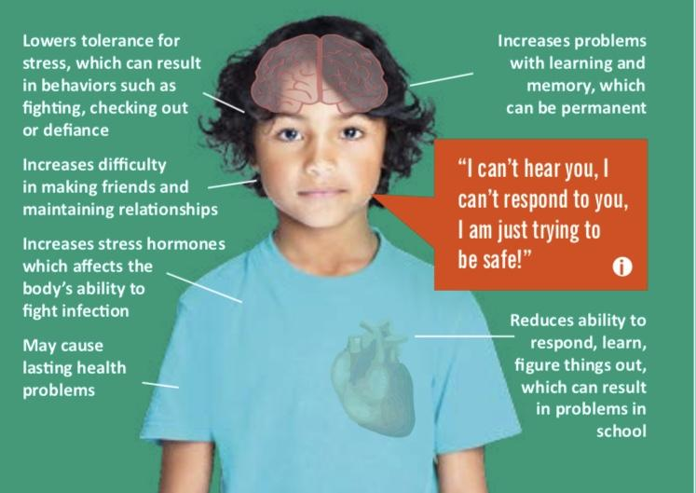
Notes:
The chronic fight or flight stress response manifests itself in behavior and health effects.
The graphic above demonstrates the various behavioral, interpersonal, learning and health problems that a child can experience.
The chronic fight or flight stress response is the brain’s way of staying safe.
The child’s brain is in survival mode so things like learning and relationships that happen in higher parts of the brain are less developed.
Think about a time when you were scared. Were you able to recite the alphabet or even have an intelligible conversation? Most likely not. That’s because all of your brain’s energy was in survival mode.
ACEs, without supportive buffers, can cause a child’s survival part of the brain to develop a lot more quickly than the other higher reasoning parts of the brain.
7

Slide 8
KIDS AT RISK TEND TO:
Get behind in school
Start skipping school
Drop out of school
Become involved in things they should not be involved in
Often end up inserted in the Juvenile Justice or Criminal Justice system
WHICH CAN LEAD TO:
Homelessness
Inability to sustain employment
Delinquency, violence, and criminal behavior
Long term use of health, behavioral health, correctional & social services
Compromised ability to parent
Notes:
If we don’t deal with their trauma and victimization now, we probably are going to have to deal with it later.
Trauma is turning off the learning switch
8

Slide 9
The Solution
Improved cross-agency communication among first responder organizations and schools can help the increase support for students experiencing trauma.
Increased use of trauma-informed strategies by educators and school leaders will lead to improved educational and life outcomes for students experiencing trauma as a result of adverse childhood experiences.
Notes:
So, we have children experiencing trauma, becoming dis regulated coming to school causing problems and not learning who eventually give up. What can we do? Handle them with Care.
Here is how:
First responders are on the front-line witnessing child maltreatment and children at risk. If a first responder is there and children are present, these are the children most at risk to go into the system. They can initiate the process of ringing the bell to alert schools of children who might need some extra care immediately following a potentially traumatic experience.
Schools can become trauma informed. It is frustrating for all involved when dealing with a traumatized child and being completing unaware of what trauma is, what is looks like, how it manifests itself in the classroom and what teachers and staff can do to address the trauma so the child can feel safe and learn. Trauma responsive classrooms and schools address the trauma so the child can feel safe and learn. This works with children we know are struggling and children who are flying under the radar and struggling.
9

Slide 10
LAW ENFORCEMENT PERSPECTIVE

Slide 11
The HWC MO Notice
Notes:
11

Slide 12
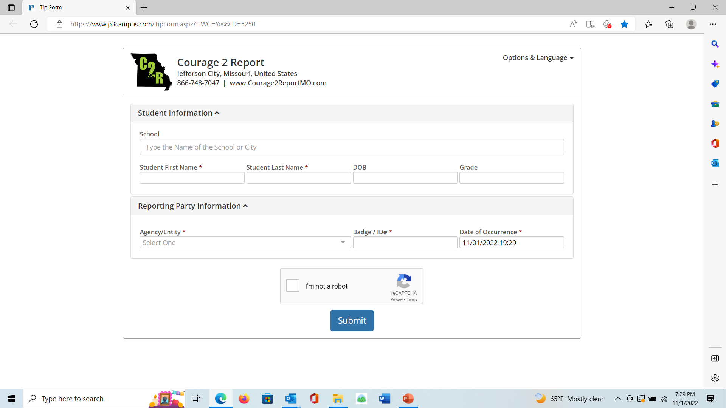
The HWC Notice
Notes:
12

Slide 13
MISSOURI NOTIFICATIONS

Slide 14
In the 26 months since our electronic notification system began operating, there have been 606 HWC notifications made by participating law enforcement agencies. Currently, 25 law enforcement agencies are practicing HWC, with 15 coming on board after September 1, 2024.
Notes:
Introduce yourself including your background in the field.
14

Slide 15
How does the HWC Notice Work in
Missouri?
Law enforcement agencies will receive a URL code that allows them to use an electronic notification system
HWC notifications will be distributed through MSHP/MIAC. MJJA will supply sites with data each month on the number of HWC notifications made
Notes:
You must have First Responders to initiative the program. We don’t have a program without them.
15

Slide 16
HWC Notice
It’s only three words: Handle with Care
No details are ever given
It should arrive at the school before the start of the next school day
Need to know basis only at the school
Does not stay in child’s permanent record
It does not mean you approach the child
Notes:
16

Slide 17
Confidentiality
Sending a HWC notification does not violate confidentiality because the notice contains only the student’s name, the school name, and these three words:
HANDLE WITH CARE
NO DETAILS of the incident are given to the school.
Notes:
17

Slide 18
Who receives the HWC notice at the School District?
In WV there is a HWC Coordinator in every county. That’s because they have ONE school district in each county.
In MO, we have 519 public school districts, so we will need a HWC Coordinator in each school district.
Essential Notifications
Only teachers who work
with the child
Counselor
School Nurse
Optional notification
Superintendent
Bus Drivers

Slide 19
HWC MO in Schools
Notes:
19

Slide 20
ill
HWC MO in Schools
Handle With Care sets schools up to be proactive, rather than reactive. With informed, caring personnel ready to respond with trauma-informed interventions, the outcomes of a traumatic situation will likely be minimized.
This can reduce disciplinary action and absenteeism while building resilience, self-respect, and confidence.
Notes:
20

Slide 21
The Solution A Trauma-Informed School
A respectful and safe environment where children can build positive relationships with adults and peers, learn to manage their emotions and behavioral responses, and find academic success.
Notes:
See Helping Traumatized Children learn
When a Child Walks Through the School Door
They need to feel safe
They need to feel loved
They need to feel cared for
Their basic needs will be meet
And they know you we want them to succeed
~Dr. Rikki McCormick, Lincoln County, WV Department of Exceptional Children
21

Slide 22
Mental Health Services
Notes:
22

Slide 23
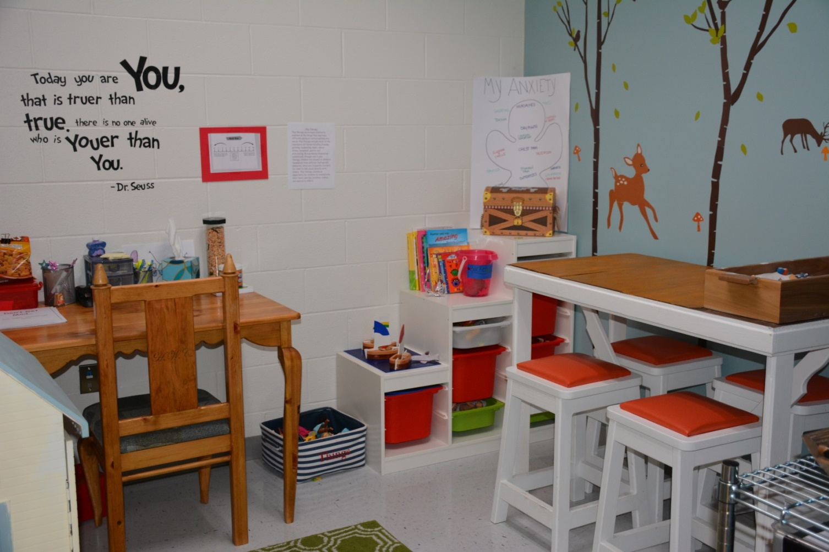
What if school interventions are not enough?
Notes:
The 3rd part of the HWC program is therapy on site at the school with parent/guardian permission
23

Slide 24
Why use outside intervention?
Notes:
School counselors have many administrative duties at the school. They can do some crisis counseling but some children need more then that.
School counselors, social workers and psychologists are professionals tasked with acting in the best interest of the school and of the student body. The mental health provider is tasked with the best interests of the child client. Sometimes these interests may conflict
24

Slide 25
HWC In Summary
Identifies the kids most at risk
Provides teachers with a heads up
Connects children with accessible mental health services if needed
Strengthens and improves relationships in the community
Improves academic, social-emotional & behavioral outcomes
Reduces a child’s risk of being inserted into the juvenile justice system for behaviors at school
Notes:
25

Slide 26
THANK YOU for your interest in HANDLE WITH CARE MO

Slide 27
CONTACT INFORMATION
Tammy Walden
School Response Coordinator
Missouri Juvenile Justice Association
308 East High Street, Suite 105
PO Box 1332
Jefferson City, MO 65102
573.616.1058 (office)
573.745.0844 (cell)
tammy@mjja.org
www.handlewithcaremo.org
Notes:
27

