Slide 1
Meeting the Mental Health Needs of
Deaf and Hard of Hearing Consumers
Presented by:
[First Lastname]
Deaf Services Advocate
Written by:
David S. Kingsbury, MA
Director, DMH Office of Deaf Services
Version: Dec 2019

Slide 2
Overview
Introduction to Hearing Loss
Deaf Mental Health Services Parity
Serving Deaf Consumers: Overcoming Barriers
The DMH Deaf Services System: Access and Standards of Care

Slide 3
Introduction to Hearing Loss
“The view of deafness as disability is tempered by the consideration that the vast majority of functional limitations of deafness would be overcome as effectively by hearing people learning sign language as by deaf people becoming hearing.”
(Kingsbury, 2011, p. 11)

Slide 4
Defining Deaf
Audiological Definition
  Usually refers to a hearing loss in the severe to profound range, greater than 70 dB.
  Most commonly used by medical professionals.

Slide 5
Defining Deaf
Educational Definition (IDEA)
  A hearing impairment that is so severe that the child is impaired in processing linguistic information through hearing, with or without amplification, that adversely affects a child's educational performance.
  Used by schools to determine eligibility for special education.

Slide 6
Defining Deaf
Cultural Definition
  Sociolinguistic identity of those in the Deaf community based on shared language, values, behavior norms, and experiences.
  Commonly noted by capitalizing Deaf to indicate usage as a proper noun.
  Most commonly used by those who know ASL.

Slide 7
Defining Deaf
Functional Definition (DMH Definition)
  An inability, because of a hearing loss, to discriminate speech when spoken in normal conversational tone regardless of the use of amplification devices.
  Used in DMH regulations and contracts.
  Similar definition in 209.261, 302.174, and 476.750, RSMo.
  Variations often used in demographics research.

Slide 8
Defining Hard of Hearing
Audiological Definition
  Usually refers to a hearing loss in the mild, moderate, or moderately severe range, from 26 to 70 dB.
  Most commonly used by medical professionals.

Slide 9
Defining Hard of Hearing
Educational Definition (IDEA)
  “Hearing impairment” is an impairment in hearing, whether permanent or fluctuating, that adversely affects a child's educational performance but that is not included under the definition of deafness.
  Used by schools to determine eligibility for special education.

Slide 10
Defining Hard of Hearing
Functional Definition
  A hearing loss that results in difficulty discriminating speech when spoken in normal conversational tone but still allows the person to rely primarily on speech and listening for communication regardless of the use of amplification devices.
  Variations may be used in demographics research.

Slide 11
A Note on Offensive Terms
Deaf
Hard of Hearing
Versus
Deaf-Mute
Deaf and Dumb
Hearing Impaired

Slide 12
Estimated Prevalence of Hearing Loss by Type
Hearing Disability 3.6%
(National Center for Health Statistics, 2012, 2015; US Census Bureau, 2012, 2017)

Slide 13
Estimated Prevalence of Hearing Loss by Type
Hearing Disability 3.6%
(National Center for Health Statistics, 2012, 2015; US Census Bureau, 2012, 2017)

Slide 14
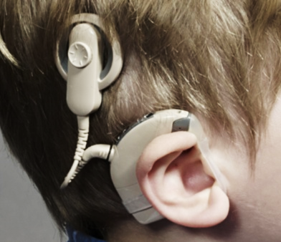
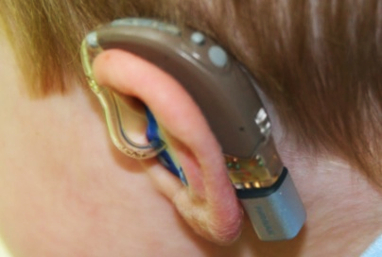
Assistive Technologies
Hearing Aids
Cochlear Implants
Programmed to amplify natural sounds to match hearing threshold.
Increase stimulation to damaged portions of the ear.
Less effective for higher frequencies.
Effectiveness decreases as hearing loss increases.
Convert natural sounds to electrical impulses.
Bypass damaged portions of the ear to stimulate the auditory nerve.
Less effective for lower frequencies.
Effectiveness may vary considerably.
Neither option restores normal hearing.

Slide 15

Cochlear Implant Simulation
youtube.com/embed/SpKKYBkJ9Hw

Slide 16
Common Methods of Communicating
American Sign Language (ASL)
  Linguistically complete, natural language with vocabulary, syntax, and grammar that are distinct from English.
Speechreading
  Combined use of lipreading, residual hearing, and other natural cues to improve comprehension of spoken English.
Manually Coded English (MCE)
  Invented communication systems that visually represent linguistically incomplete English (most common is SEE2).
Simultaneous Communication (SimCom)
  Use of speech and any form of MCE at the same time.

Slide 17
Language and Communication
Historically, hearing people have viewed signed languages as inferior to spoken languages.
Current research shows that signed languages like ASL are linguistically equal in complexity and communication potential.
Research clearly demonstrates that learning sign language does not harm speech development.
Research also suggests that learning sign language may help speech development.

Slide 18
Language Fluency/Dysfluency
Deaf people may not be fully fluent in a first language due to language deprivation or delayed language exposure as a child.
Deaf people with mental illness are more likely to have dysfluency.
Deaf people may have a low reading level or be functionally illiterate due to delayed language exposure/language deprivation and inadequate education.
The average high school graduate reads just below a 4th-grade level.

Slide 19
Deaf Mental Health Services Parity

Slide 20
Deaf Mental Health
Deaf and hard of hearing adults have at least the same prevalence of mental illness as hearing people.
Children with hearing loss have significantly higher rates of behavior problems and mental illness than their peers.
Deaf and hard of hearing experience at least 3-5 times higher rates of abuse and neglect.

Slide 21
The Deaf Services Parity Gap
In Missouri
30% of individuals with SMI present for services at CMHCs.
An estimated 28% of Deaf with SMI present for services at CMHCs.
We have a director of Deaf Services and a range of specialized services.
This positions Missouri as a national leader in Deaf mental health care.
Challenges remain in quality of care due to the shortage of ASL-fluent and culturally competent providers. ~61% of Deaf consumers are served by non-signing clinicians and case managers, many of whom have little or no training in Deaf culture or Deaf mental health.

Slide 22
The Legal Basis for Parity
Rehabilitation Act, Section 504
  Requires nondiscrimination in any program or activity receiving Federal financial assistance.
Americans with Disabilities Act, Title II
  Requires nondiscrimination in all services, programs, and activities provided or made available by public entities including those provided by contractors.
Americans with Disabilities Act, Title III
  Requires nondiscrimination in places of public accommodation.
Affordable Care Act, Section 1557
  Requires notification of nondiscrimination and the availability of communication access.
  Extends ADA Title II standards for effective communication to covered private healthcare providers.

Slide 23
The Legal Basis for Parity
Deaf and hard of hearing individuals must receive equal opportunity to gain the same benefit or obtain the same result as others.
Communication with deaf and hard of hearing individuals must be as effective as communication with others.
Auxiliary aids and services must be provided when needed for effective communication.
Phone calls from individuals using telecommunications relay services (TTY/TDD, Video Relay Service, CapTel, etc.) must be answered and treated the same as other calls.

Slide 24
Examples of Auxiliary Aids and Services
“The type of auxiliary aid or service necessary to ensure effective communication will vary in accordance with the method of communication used by the individual; the nature, length, and complexity of the communication involved; and the context in which the communication is taking place (ADA Title II and Title III regulations).”
ASL-fluent provider
On-Site Interpreting
Video Remote Interpreting (VRI)
Computer-Aided Real-time Transcription (CART)
Written Materials and Exchanging Written Notes
See ADA Guide to Effective Communication at www.ada.gov/effective-comm.htm and
Effective Communication under ADA Title II and Section 1557 at dmh.mo.gov/deafservices/providers

Slide 25
Determining Which Auxiliary Aid or Service
ADA Title II & ACA Section 1557
ADA Title III
In determining what types of auxiliary aids and services are necessary, a public or covered entity shall give primary consideration to the requests of individuals with disabilities.
Primary consideration means that the covered entity must honor the choice of the individual unless it can demonstrate that another equally effective means of communication is available, or that use of the means chosen would result in a fundamental alteration or undue burden.
A public accommodation should consult with individuals with disabilities whenever possible to determine what type of auxiliary aid is needed to ensure effective communication, but the ultimate decision as to what measures to take rests with the public accommodation, provided that the method chosen results in effective communication.

Slide 26
Determining Which Auxiliary Aid or Service
ADA Title II & ACA Section 1557
ADA Title III
Effective communication is determined from the perspective of both the covered entity and the consumer –
Not just from the perspective of the covered entity.

Slide 27
Serving Deaf Consumers
Overcoming Barriers

Slide 28
Communication Barriers
Front line staff unaware of communication needs and available accommodations.
Providers lack knowledge of effective communication practices and how to work with an interpreter.
Written materials typically composed at a high-school or college reading level and not explained in person.

Slide 29
Effective Communication
Staff need to be aware of the availability of communication accommodations.
Plan in advance for interpreters or other communication accommodations.
Plan for effective communication to take longer, especially for assessments and treatment planning.
Develop simplified English versions of written information and/or fully review written information with an interpreter present.

Slide 30
Boundaries of Cultural Competence
Accreditation standards require agencies to address service access for cultural and linguistic minorities.
Professional licensure rules and codes of ethics limit scope of practice to a provider’s boundaries of competence. This includes competence with any special population: cultural, linguistic, disability, age, religion, LGBT, etc.
“Cultural distance” is the degree of difference between the provider’s culture and the consumer’s culture.
The greater the cultural distance, the more culture-specific knowledge and skills will be needed to provide competent services.
Recognizing limits of cultural competence requires general multicultural knowledge and skills. “I can do it all” mentality is common but unethical.

Slide 31
Boundaries of Cultural Competence
Providers often lack adequate:
  Conscious awareness of their own culture.
  Multicultural and culture-specific training.
  ASL fluency.
  Knowledge of the unique psychosocial and developmental aspects and mental health needs of the Deaf community.
  Understanding of Deaf culture.
  Understanding of how the above impact the ability to provide competent mental health assessment and treatment to deaf individuals.

Slide 32
Developing Competence in Deaf Mental Health Care
Deaf mental health care is an established specialized area of practice involving distinct:
  Cultural considerations.
  Language and communication needs.
  Psychosocial and developmental considerations.
Developing specialized competence in Deaf mental health care typically requires 1-3 years of training and practice under qualified supervision or consultation.
Developing the fluency necessary to provide clinical services in ASL typically takes 5-7 years.

Slide 33
The DMH Deaf Services System
Access and Standards of Care

Slide 34
DMH Office of Deaf Services
Agency-wide (CPS, SUDT, and DD) responsibility for issues that affect deaf, hard of hearing, and deaf-blind consumers.
Program and policy development, clinical standards of care, and best practices.
Training, consultation and technical assistance for DMH facilities and contracted providers.
David S. Kingsbury, MA, Director
david.kingsbury@dmh.mo.gov
573-526-1857
dmh.mo.gov/deafservices

Slide 35
Specialized Deaf Services Delivery Options
Specialized Outpatient Centers (SOCs)
ReDiscover Deaf Services
Brandy Haddock, MS, LPC
1535 NE Rice Road
Lee's Summit, MO 64086
Voice: 816-966-0900
bhaddock@rediscovermh.org
BJC Behavioral Health Deaf Services
Laura Shapiro, MSW, ACSW, LCSW
3165 McKelvey Road, Suite 200
Bridgeton, MO 63044
Voice: 314-206-3499
VP: 314-266-2636
laura.shapiro@bjc.org
Core CPR services provided by staff who are ASL fluent and/or have specialized training in Deaf culture and Deaf mental health care.
ASL-fluent QMHPs and Community Support Specialists.
Regular CMHC service area boundaries do not apply.
Telehealth individual counseling available statewide.

Slide 36
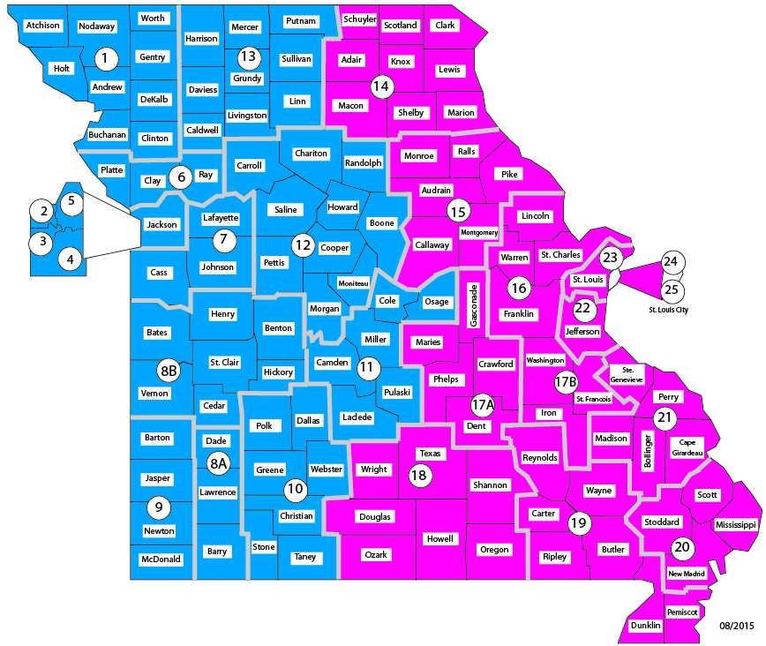
Deaf Services SOC Telehealth Regions
Eastern: BJC Behavioral Health
Laura Shapiro, MSW, LCSW
Western: ReDiscover
Brandy Haddock, MS, LPC

Slide 37
Specialized Deaf Services Delivery Options
Specialized Inpatient Units (SIUs)
Truman Medical Center
Behavioral Health (Acute)
Robert Ellis, Program Director
1000 E. 24th St.
Kansas City, MO 64108
Voice: 816-404-3800
robert.ellis@tmcmed.org
Provides adult acute inpatient services with an interpreter. Staff are trained in Deaf culture and Deaf mental health care.
Admissions are through Truman’s emergency room or by transfer from another hospital.
St. Louis Psychiatric Rehabilitation Center Deaf Services Unit (Intermediate/Long-Term)
Peter Scheers, MS, Program Director
5300 Arsenal St.
St. Louis, MO 63139
Voice: 314-877-5945
peter.scheers@dmh.mo.gov
Provides intermediate and long-term inpatient services. Some services are provided with an interpreter, and some services are available directly in American Sign Language.
Admissions are through CMHCs.

Slide 38
DEAFline Missouri Crisis Hotline
Statewide 24-Hour crisis hotline for deaf and hard of hearing individuals.
  Text HAND to 839863
  TTY or voice call to 800-380-3323
  Videophone call to 573-303-5604

Slide 39
Requirements for All CMHCs
Deaf consumers have choices:
  Access all services from SOC or all services from local CMHC;
  Access specialized services from SOC and other services from local CMHC.
  Access specialized counseling via telehealth or regular counseling at local CMHC;
  Other services (e.g. assessments) may be arranged by telehealth on a case-by-case basis.
  Unless a choice is clinically contraindicated.

Slide 40
Requirements for All CMHCs and SUDT Providers
For deaf consumers who use ASL, unless the consumer requests an alternative communication method, a “category of mental health service” must be delivered in ASL:
  Preferably by an ASL fluent staff member;
  Alternately with a qualified interpreter;
  Video Remote Interpreting (VRI) may not be used unless an interpreter cannot be physically present in a timely manner.
For deaf consumers who do not use ASL, reasonable, good faith efforts must be made to provide alternative communication methods.
In many cases, a requested accommodation cannot be denied unless the decision has been made in writing by the DMH director or his/her designee. Contact the Office of Deaf Services for details.

Slide 41
Requirements for All CMHCs and SUDT Providers
“Category of mental health service” means one of the following services funded by DMH:
  An initial assessment, including diagnosis;
  A periodic reassessment;
  A treatment or discharge planning meeting with the client present;
  A visit with a contract or employee physician;
  An individual psychotherapy/psychoeducational session; or
  A group psychotherapy/psychoeducational session.

Slide 42
Requirements for All CMHCs and SUDT Providers
How do I know if a staff member is ASL fluent?
  Contact the Office of Deaf Services for criteria.
  Fluency must be documented with the Office of Deaf Services.
Under the Prospective Payment System (PPS), Certified Community Behavioral Health Organizations can include enhanced pay for bilingual/multilingual providers in their cost reports to increase their overall daily reimbursement rate.
Under Fee-for-Service (FFS), enhanced billing rates are available for certain services when provided by ASL-fluent staff.

Slide 43
Requirements for All CMHCs and SUDT Providers
What is a “qualified interpreter?”
  Impartial (not family, friend, or companion);
  Can interpret effectively and accurately, both receptively and expressively, using any necessary specialized vocabulary, terminology, or phraseology;
  Adheres to generally accepted interpreter ethics principles, including confidentiality.
What is an “appropriately certified interpreter?”
  Advanced or Master Missouri certification (not Basic).

Slide 44
Requirements for All CMHCs and SUDT Providers
How do we get reimbursed for interpreting services?
  Under PPS, interpreting is entered in CIMOR as a cost-only service that does not trigger a payment. Associated costs should be included in cost reports so that they are built into the daily rate.
  Under FFS, interpreting is billed in CIMOR when provided in conjunction with a “category of mental health service” funded by DMH.
  In Medicaid managed care and private pay, interpreting costs are not reimbursable and are generally considered overhead.
Interpreters who have completed DMH’s Introduction to Mental Health Interpreting course receive preferential hiring.

Slide 45
Requirements for All CMHCs and SUDT Providers
What about services other than a “category of mental health service?”
  Section 1557 effective communication requirements apply.
  For DMH services, both Title II and Title III apply.
  For non-DMH services, Title III applies.
  The appropriate auxiliary aid or service should be determined using the USDOJ’s ADA Guide to Effective Communication.
  DMH typically does not reimburse interpreting costs.

Slide 46
What Else Can I Do?
Read American Ways (3rd ed, 2011) by Gary Althen to develop a better conscious understanding of American culture.
Learn about Hofstede’s Cultural Dimensions.
Take continuing education focused on developing basic cultural competence.
Take an Office of Deaf Services webinar.
If you provide services to a deaf consumer, take DMH’s Deaf Services Training in Relias Learning.
If you provide services to a hard of hearing consumer, take the Working with People with Hearing Loss training on the Office of Deaf Services website.
Contact the Office of Deaf Services for consultation.

Slide 47
DMH Office of Deaf Services Online Resources
Deaf Services Homepage:
    dmh.mo.gov/deafservices
Information for Providers:
    dmh.mo.gov/deafservices/providers
Training Resources:
    dmh.mo.gov/deafservices/training
Deaf Services Advocates Manual:
    dmh.mo.gov/deafservices/dsamanual

Slide 48
Questions?
[First Lastname]
Deaf Services Advocate
[name@organization.com] | [123-456-7890]
David S. Kingsbury, MA
Director, DMH Office of Deaf Services
david.kingsbury@dmh.mo.gov | 573-526-1857
dmh.mo.gov/deafservices
Look for the “Information for Providers”
and “Training” links on the right.

