Slide 1
Working with Tenants
2019 DMH RENT Conference

Slide 2
The law is subject to change.
We provide this information as a public service but it is NOT legal advice.
We encourage you and your clients to consult with a lawyer.

Slide 3
Remember:
1. Tenants Have Rights
2. Housing is a Human Right

Slide 4
Human rights are moral principles or norms that describe certain standards of human behavior and are regularly protected as natural and legal rights in municipal and international law.
They are commonly understood as inalienable, fundamental rights "to which a person is inherently entitled simply because she or he is a human being" and which are "inherent in all human beings", regardless of their nation, location, language, religion, ethnic origin, or any other status. They are applicable everywhere and at every time in the sense of being universal, and they are egalitarian in the sense of being the same for everyone.
They are regarded as requiring empathy and the rule of law and imposing an obligation on persons to respect the human rights of others, and it is generally considered that they should not be taken away except as a result of due process based on specific circumstances

Slide 5
Access to adequate housing directly affects the realization of other human rights:
Employment is difficult to secure and maintain
Health is threatened
Education is impeded
Violence is more easily perpetrated
Privacy is impaired
Places vulnerable groups in the impossible position of having to choose between the most basic of human necessities:
between housing and food
between housing and health care
between housing and clothing

Slide 6
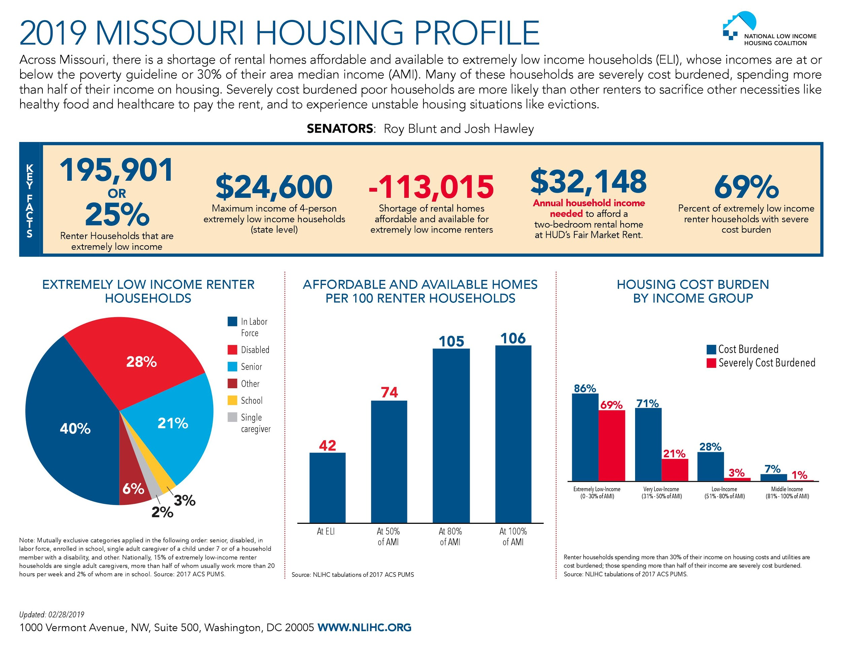

Slide 8
Looking for a home →
Signing a lease →
LIVIN →
Lease Termination/Eviction →
Moving Out

Slide 9
Looking for a home →
Location
Size
Habitability
Homework
Cost

Slide 10
Looking for a home → Location
Drive/walk/bike around the neighborhood at different times
Where does your client need to be?

Slide 11
Looking for a home → Size
Does your client need an occupancy permit or inspection? Should they get one? Who will pay?
What is the occupancy load?

Slide 12
Looking for a home → Habitability
Inspect every room - bugs/rodents, closets, storage areas
Make sure everything works - windows, doors, faucets, appliances, drains, toilets, air conditioning
NEVER let a tenant rent a property they have not seen
NEVER let a tenant enter into a lease for a property that already needs repairs

Slide 13
Looking for a home → Homework
Call the city - are there existing code violations or condemnations? Last valid occupancy permit?
Property taxes paid?
Property lookup - who owns the place?
Lead hazards?
Court records?
Utility costs?
Nuisance/problem property?

Slide 14
Looking for a home → Costs
Occupancy permit(s)?
Security deposit?
Monthly rent?
Utility responsibilities?

Slide 15
Security Deposit
Payment intended to cover the expenses of damages exceeding normal wear and tear after the tenant moves out
Landlord can charge no more than 2 months rent
Give/get a receipt – and don’t pay cash
Non-refundable security deposits are illegal (unless pet deposit)

Slide 16
Signing a Lease →
Lease:
A lease is an agreement between a tenant and a landlord regarding the tenant’s right to use a piece of property.
A lease is both a contract (an agreement between two or more parties) and a conveyance (a transfer of a property interest).
Types of Leases:
Oral Lease: A lease that is not in writing, often month to month.
Written Lease: A lease for more than one year must be in writing.

Slide 17
Signing a Lease → What Terms Should be Discussed in Every Lease?
Name of the landlord and tenant.
Address of property being rented.
The term of the lease.
The amount of rent and the date the rent is due.
Where the rent payment is made.
The amount of security deposit.
Who pays each utility (gas, electric, water, sewer, trash).

Slide 18
Signing a Lease → What Terms Should be Discussed in Every Lease?
What repairs the landlord will make.
What repairs the tenant will make.
Who is allowed to live in the property
Whether the landlord will provide any appliances, and if so, who is responsible for repair?
The phone number and address for the landlord.
When the landlord may enter the property and for what purposes.

Slide 19
ONLY sign a lease in a location where the tenant can immediately get their own photocopy of the original lease agreement signed by both parties.

Slide 20
LIVIN →
Take photos of the unit before the tenant moves in to document its condition.
Notify the landlord of defects by making a written list of repairs needed. https://www.archcitydefenders.org/wp-content/uploads/2019/10/Tenant-Conditions-Checklist.pdf

Slide 21
LIVIN →
Get and keep all rent receipts - DON’T PAY CASH
Renter’s Insurance!
Notify the landlord when something breaks
Confirm side agreements in writing and make sure each party has its own photocopy
Confirm repair requests in writing and keep a photocopy
Tenants CAN have guests

Slide 22
LIVIN → General Tenant Duties:
Follow the terms of the lease.
Pay rent when it is due.
Throw out trash and clean the home so it does not attract rodents or bugs.
Take care of the home and do not purposely damage the home.

Slide 23
LIVIN → General Tenant Duties:
Do not bother other tenants.
Follow local municipal (city) and county codes.
Obtain an occupancy permit if the city or county requires a tenant to apply for it.
Allow the landlord entry into the home to make repairs provided landlord gives reasonable notice.

Slide 24
LIVIN → Tenants should...
Cashier’s check or money order
Rent receipts
Always communicate or confirm in writing
Pictures
Side agreements

Slide 25
LIVIN → Tenants can...
Repair and deduct
Terminate lease
Ask for help!

Slide 26
LIVIN → General Landlord Duties:
Make the property habitable (safe and healthy to live in) before the tenant moves in and maintain property in habitable condition (implied warranty of habitability).
Make repairs as required by lease, local, state or federal law.
Follow the terms of lease such as paying certain utilities and providing working keys to the home.
Provide appropriate notice if the landlord is terminating the lease.

Slide 27
LIVIN → General Landlord Duties:
If required by the municipality, obtain necessary permits and inspections before renting the home.
Give reasonable notice before entering home to make repairs, etc.
Not interfere with or interrupt utilities such as water, electric, gas, etc.
Provide his or her business address to the tenant

Slide 28
Lease Termination/Eviction →
What is a Lease Termination?
If the landlord thinks tenant violated the lease, the landlord may send a notice of lease termination asking them to move.
The type of notice and time given to may vary depending upon the lease and the law.
If lease has expired, the landlord may or may not have to ask tenant to move.

Slide 29
Lease Termination/Eviction →
What is an Eviction?
An eviction is a legal procedure a landlord uses to remove a tenant from rental property. If tenant fail to perform their duties under the law or the lease, landlord may use the failure to perform as a reason to evict.
A landlord who wants to evict a tenant must file a lawsuit, obtain a judgment for possession, and request a sheriff to remove you and your belongings.
Depending upon the type of lawsuit, the landlord may ask for possession of the unit, rent, late fees, double rent, double damages, court costs, and attorney’s fees.

Slide 30
Lease Termination/Eviction →
Lockouts and Utility Shut Offs
Missouri law prohibits “self- help” evictions by landlords.
It is illegal for a landlord to change the locks, remove doors, shut off utilities or throw a tenant’s belongings out of the unit. It is also illegal for a landlord to threaten “self-help” eviction.
St. Louis City Ordinance

Slide 31
Moving Out →
Leave the unit clean and empty
Pictures
Schedule a walk-thru inspection with both the landlord and tenant present.
Tell the landlord where to send security refund and/or statement

Slide 32
Moving Out → Security Deposit
Once a tenant moves out, a landlord has 30 days to either return the deposit or give the tenant an itemized statement of any amounts withheld.
Landlord does not have to return deposit before a tenant moves
Landlord can apply deposit to unpaid rent and/or damages after tenant vacates

Slide 33
Fair Housing Act
Prohibits discrimination by direct providers of housing (landlords, real estate companies, property managers, banks, lenders, municipalities, insurance companies, etc.) whose discriminatory practices make housing unavailable to persons because of:
Race
Religion
Sex
National origin
Familial status
Disability

Slide 34
Fair Housing Act
Also…..
Source of Income
Sexual Orientation

Slide 35
Fair Housing Act
Disparate impact v. disparate treatment
Treatment: treated victim differently than other tenants in a similar situation
Impact: housing providers policy has a greater impact on one group over another based on statistics (i.e. victims of domestic violence statistically women, thus, sex discrimination)

Slide 36
ArchCity Defenders
Legal Services of Eastern Missouri
EHOC
ACLU
Macarthur Justice Center
SLU Law Clinic
CLAM

Slide 37
ArchCity Defenders
www.archcitydefenders.org

