Slide 1
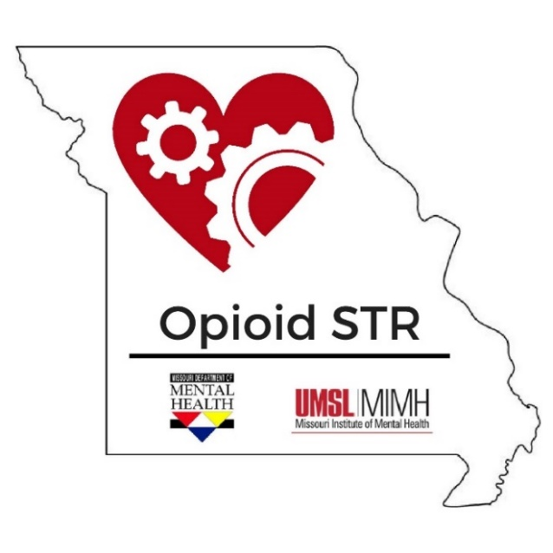
Missouri’s State Targeted Response to the Opioid Crisis…
What we’ve done and have yet to do
Rachel Winograd, PhD
State Targeted Response Project Director
Missouri Institute of Mental Health
University of Missouri, St. Louis

Slide 2
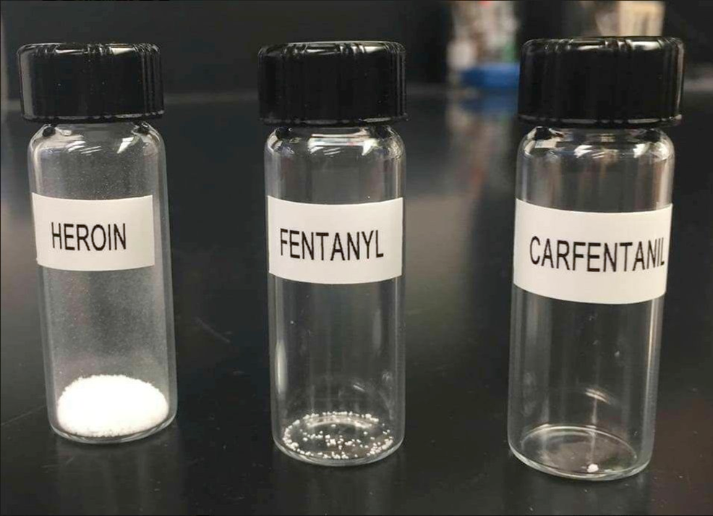

Slide 3

Total Number of
Opioid-Related
Overdose Deaths in 2016
35%
increase
from
2015
to
2016
908
Source: DHSS, 2017
Notes:
2015 opioid-related overdose deaths: 672

Slide 4
Total Number of
Opioid-Related
Overdose Deaths in 2017
4.7%
increase
from
2016
to
2017
951
Source: DHSS, 2018
Notes:
2015 opioid-related overdose deaths: 672

Slide 5
Deaths Due to Heroin Overdoses
2012-2016
Crude rate per 100,000 population
Source: MO Dept of Health and Senior Services

Slide 6
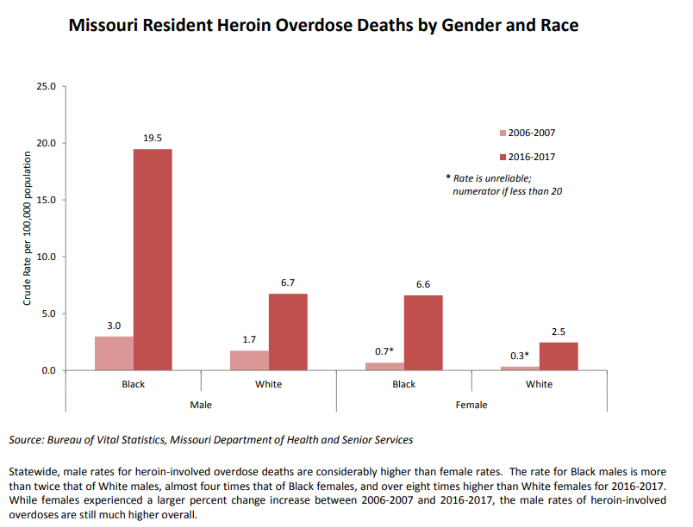
Notes:
Either 19 or 20

Slide 7
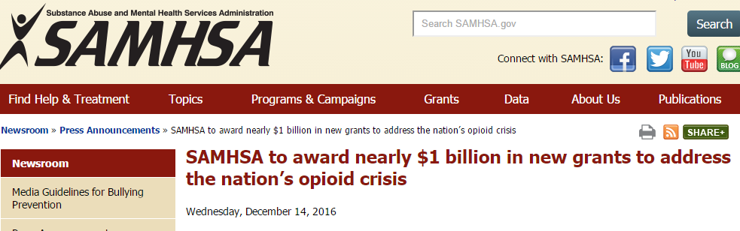
State Targeted Response to the Opioid Crisis Grants (Opioid STR)
Missouri: $10,015,898 x 2 years = $20,031,796
Service grant; at least 76% for treatment & recovery support

Slide 8
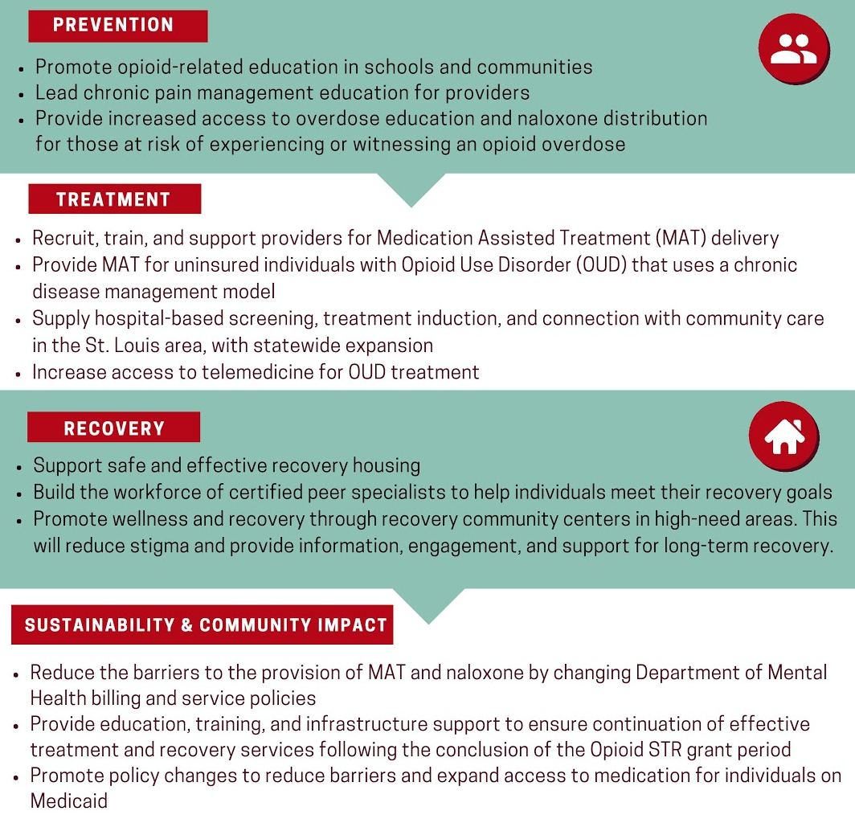

Missouri’s
Plan
“Combined with coordinated collaboration and sophisticated evaluation,
The Opioid STR project aims to transform the system of care for OUD in Missouri.”

Slide 9
Missouri’s Plan
NEED: To transform the system of care for OUD in Missouri
IN WHAT: Prevention, Treatment, & Recovery Support
DELIVERED HOW: Training, Consultation, & Direct Service with a Medication First treatment model
TO: SAVE LIVES.

Slide 10
Prevention

Slide 11
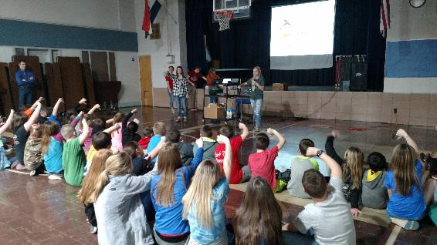
Generation Rx Results - NCADA
Year 1 Outcomes:
3,152 students educated
38% increase in students that correctly identified example of misusing prescription drugs
23% increase in students that strongly disagree with: “Prescription drugs are safer to misuse than other drugs.”
96% of students agreed that Gen Rx influenced them to avoid
misusing prescription drugs

Slide 12
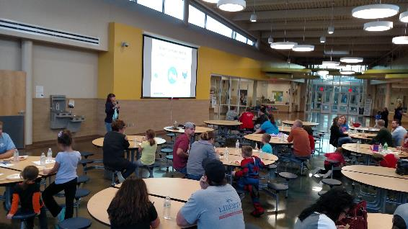
Generation Rx Results
Community Partnership of the Ozarks
Year 1 Outcomes:
1,565 students educated
127 educators trained in train-the-trainer sessions to deliver curriculum
25% knowledge gain regarding impact of medication misuse among teens
70% gain in knowledge regarding impact of opioid crisis
68% gain in awareness of
resistance skills and refusal
strategies

Slide 13
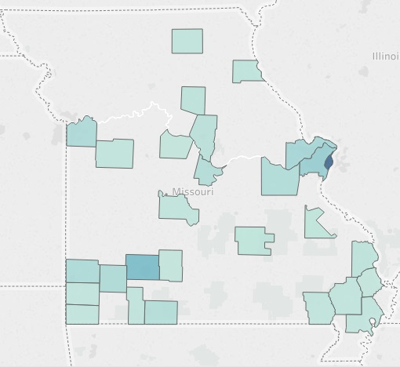

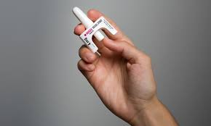
Overdose Education and Naloxone Distribution
*OEND training has been provided to 4,061 individuals across various settings including criminal justice, pharmacy, recovery housing, and recovery support groups.

Slide 14
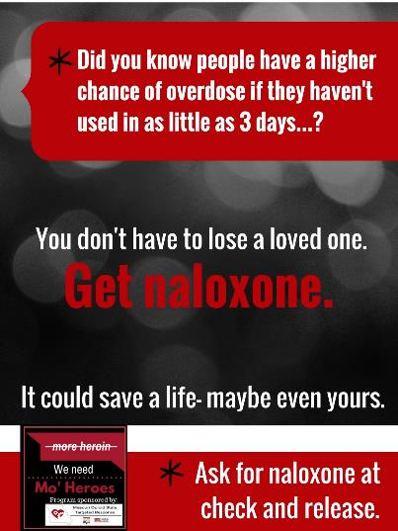
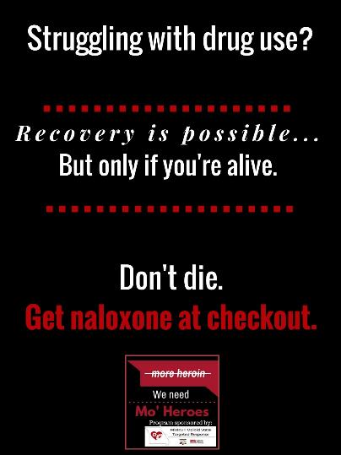
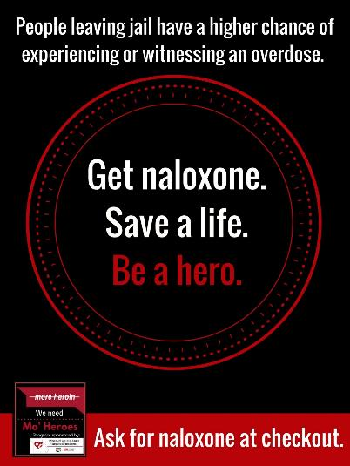
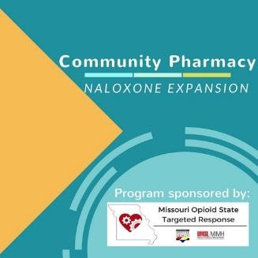

Slide 15
Treatment

Slide 16
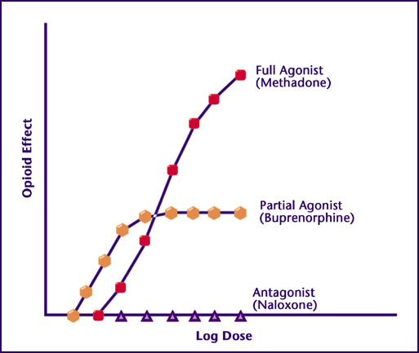



(Naltrexone)

Slide 17
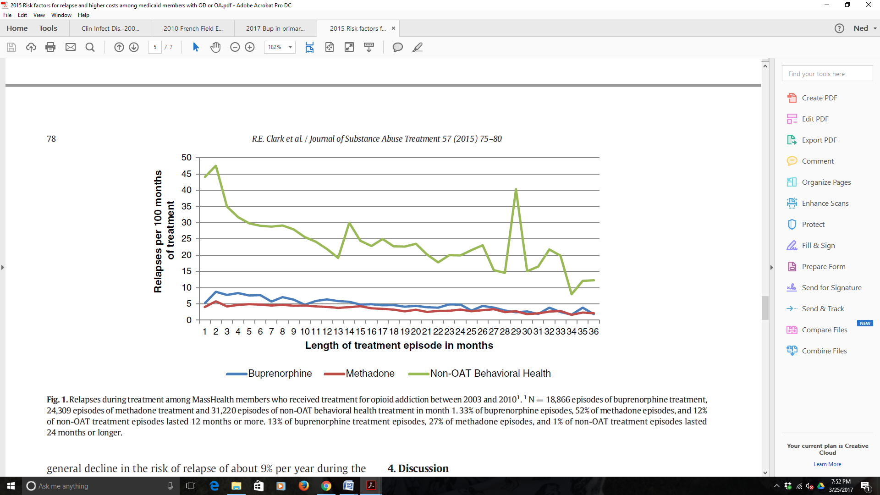
Figure 4. Clark, Robin E., et al. "Risk factors for relapse and higher costs among Medicaid members with opioid dependence or abuse: opioid agonists, comorbidities, and treatment history." Journal of substance abuse treatment 57 (2015): 75-80.
Notes:
Tracks rate of relapses by treatment condition --
Across 3 years in a Medicaid sample
Proxies for relapse events: ER visits; hospitalization; medical detox

Slide 18
Mortality Risk in and out of
Buprenorphine Treatment
Sordo, Luis, et al. "Mortality risk during and after opioid substitution treatment: systematic review and meta-analysis of cohort studies." bmj 357 (2017): j1550.
Notes:
It’s not just about getting it – it’s about staying on it

Slide 19
Prior Approach to OUD Treatment
Detoxification model of treatment for Opioid Use Disorders (OUD)
Overreliance on residential and group therapy as treatment
Approached OUD as acute care rather than chronic care
Use of agonist/partial-agonist medication such as Buprenorphine and Methadone as last resort
  When using BUP, was at low doses for short time periods
Notes:
The sign is animated – doesn’t show up until you click (view in slide show)

Slide 20
Medication First Model
1) People with OUD receive pharmacotherapy treatment as quickly as possible, prior to lengthy assessments or treatment planning sessions;
2) Maintenance pharmacotherapy is delivered without arbitrary tapering or time limits;
3) Individualized psychosocial services are offered but not required as a condition of pharmacotherapy;
4) Do not discontinue medical treatment unless it is clearly worsening the patient’s condition.

Slide 21
Missouri’s “Medication First” Model – Why?
Provides fairly immediate relief from distress caused by withdrawal symptoms
Stabilizes the client
Decreases craving
Creates mental ability for patient to engage and benefit from psychosocial treatments
Designed to:
  Increase retention in treatment
  Decrease deaths from overdose

Slide 22
DBH Policy Expectations for the Use of Medications for Opioid Use Disorder
1. Do not initiate a taper or discontinuation of buprenorphine or methadone in response to any client “infraction” (e.g., missing therapy sessions).
2. (Other side of #1) Do not mandate participation in individual or group counseling as a requirement for continued medical treatment. See #1
3. Do not set a “time limit” for maintenance medical treatment.
4. Do not encourage ‘rapid’ buprenorphine taper protocols with the goal of transitioning to antagonist medications or no medications at all.
5. Do not discharge a client based on positive drug test results for illicit substances
Notes:
Compiled from guidelines within the following sources:
American Society of Addiction Medicine (ASAM) National Practice Guidelines (2015)
SAMHSA’s Clinical Guidance for Buprenorphine Treatment TIPS 40 (2004)
The World Health Organization’s (WHO) Guidelines for the Psychosocially Assisted Pharmacological Treatment of Opioid Dependence (2009)
The FDA Drug Safety Communication (2017)

Slide 23
DBH expectations, continued…
6. Do not discharge a client from a residential setting without enough medication to supply them to their first outpatient visit.
7. Do not withhold medical treatment if the treatment provider does not have staffing capacity to provide psychosocial services at the time the client presents.
8. Do not switch a client from Vivitrol to oral naltrexone solely for cost saving purposes.
9. Do individualize dose decisions based on individual client factors, particularly craving intensity and environmental support (i.e., be wary of underdosing – most clients do best when stabilized between 16mg-24mg of buprenorphine per day).
10.Do increase client accountability measures (e.g., drug testing, frequency of medication/dosing visits) -- if and when adherence to treatment protocols becomes disrupted by client behaviors described above -- without discontinuing the needed medications. Use motivational interviewing and make clear the rationale for the recommendation of individualized psychosocial supports.

Slide 24

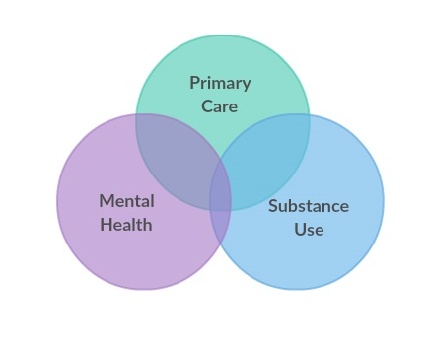
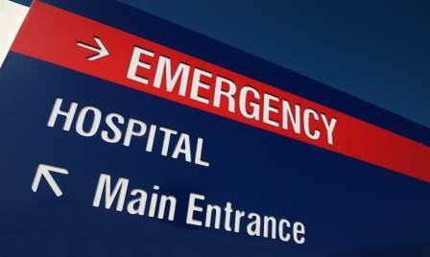
Treatment: Broad Goals to Accomplish Med First
*More buprenorphine prescribers
*OUD treated across care settings, bi-directional referrals
*Changing the standard of OUD care in SUD settings

Slide 25


STR CSTAR Treatment Update
17
Treatment agencies
2,418
Individuals Enrolled in STR for treatment as of 7/19/18
Treatment sites
45
Telehealth encounters funded through STR
1,506
38
Telehealth units purchased for treatment agencies through STR

Slide 26
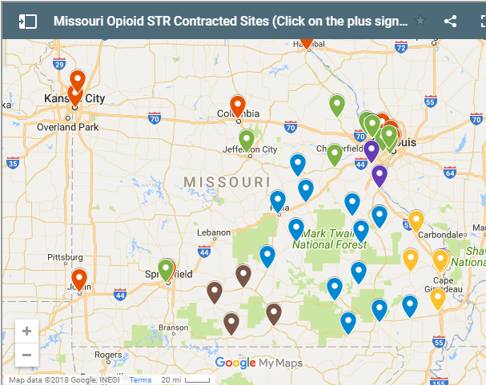
www.missouriopioidstr.org
“Get Treatment”

Slide 27
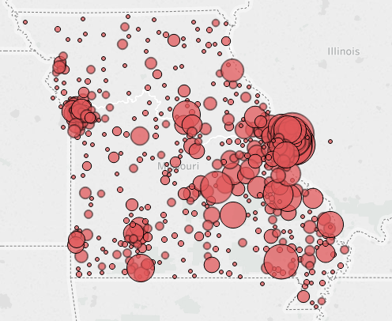
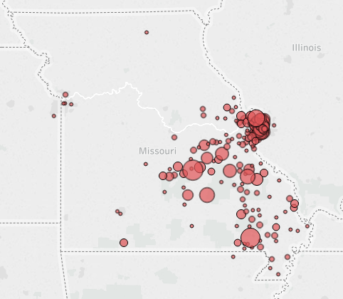
Treatment Admissions (first 6 months STR)
All CSTARS
STR Treatment

Slide 28
 | Month Contract Began for STR | # of STR EOCs | % of STR EOCs | % of Baseline EOCs
SEMO | July | 362 | 43.5% | 28.3%
ARCA | July | 327 | 39.3% | 17.5%
Center for Life | July | 120 | 14.4% | 6.0%
Queen of Peace | August | 75 | 9% | 6.6%
Westend Clinic | August | 54 | 6.5% | 3.6%
Preferred Family Healthcare | September | 138 | 16.6% | 49.6%
Gateway | October | 82 | 9.8% | 4.7%
Truman Medical | October | 4 | 0.5% | -
Gibson | November | 26 | 3.1% | 5.1%
Overall STR Enrollment by Month
(N = 837)
Notes:
Alex

Slide 29
Demographics
Educational
Attainment
Average Age = 35
(N = 789)
12th
Grade
About ¾ of STR consumers are White
Notes:
Alex

Slide 30
STR Agencies Only (N=7)
All CSTARS
Notes:
Alex
-Does not include T

Slide 31
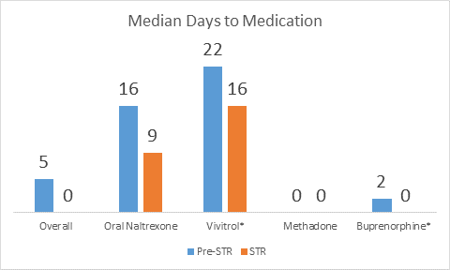
Note: Time to Vivitrol specifically is later than time to first medication in the Vivitrol group
Notes:
Claire Time to Vivitrol specifically
is later than time to first
medication in the Vivitrol
group
Non-STR baseline Vivitrol
Median: 22 Days
STR Vivitrol
Median: 16 Days
*Still comprised of any medication. E.g. Vivitrol may be lower because it includes people who got bup and then Vivitrol.

Slide 32

Peer Support Services:
12% of STR EOCs received peer support services within the first 30 days of treatment.
Hours per day of peer support services in the first 30 days of treatment was modestly and positively associated with the length of the episode of care (r = .14, p < .001) and retention at 1 and 3 months
(r = .10, p = .004; r = .13, p = .003, respectively).

Slide 33

Median Price by Medication
Overall Price of Treatment by Medication for STR Consumers and Non-STR Consumers
No Medication Oral Naltrexone Vivitrol Methadone Buprenorphine
Notes:
Claire

Slide 34
The take-aways
receive medication
get medication sooner
receive fewer psychosocial services
be engaged in treatment at 1 and 3 months
1
Individuals enrolled in STR are more likely to…
2
3
4

Slide 35
Recovery

Slide 36




Recovery Community Centers (RCCs)
4 RCCs funded in Missouri
Over 1,100 individuals received services in Year 1

Slide 37

Recovery Housing Update
Year 1 Outcomes:
25 recovery houses funded in Missouri
  Eastern region: 10 houses, 87 beds
  Western region: 8 houses, 103 beds
  Southwest region: 7 houses, 68 beds
In Year 1, 4,066 nights of housing were provided
NARR accreditation and further recovery housing will be approved in STR Year 2

Slide 38

Certified Peer Specialist Trainings
Year 1 Outcomes:
98 individuals have received training in the Certified Peer Specialist (CPS) credential
Trainings have taken place in:
  St. Louis
  Jefferson City
Year 2 trainings will take place in:
  Kansas City
  Springfield
  Cape Girardeau
  Kirksville
  Joplin
  Sikeston

Slide 39
In Year 1 of STR…
1,783 individuals have received evidence-based medical treatment for opioid use disorder (OUD)
4,318 naloxone kits have been distributed to at-risk individuals and their loved ones, and clinicians who work with at-risk populations
4,061 individuals have received training on what to do in the event of an opioid overdose
3,066 bed nights of recovery housing have been provided
Over 1,100 individuals have received recovery services at the four Recovery Community Centers (RCCs) across the state
Over 1,000 individuals have received peer-based post-overdose outreach in emergency rooms through the Engaging Patients in Care Coordination (EPICC) Project
4,633 youth have been engaged through the Generation Rx program, which increases public awareness about prescription medication misuse
Over 10,000 individuals have received training at 62 agencies through 85 trainings and consultations on topics across the spectrum of treatment, prevention and recovery. Trainings took place at a variety of settings including DMH facilities, state-funded agencies, hospitals, schools and universities, pharmacies, recovery houses, conferences, and more
29 total Chronic Pain Management and Opioid Use Disorder ECHO sessions were held, reaching 208 unique participants
98 individuals received training to obtain their Certified Peer Specialist (CPS) credential

Slide 40
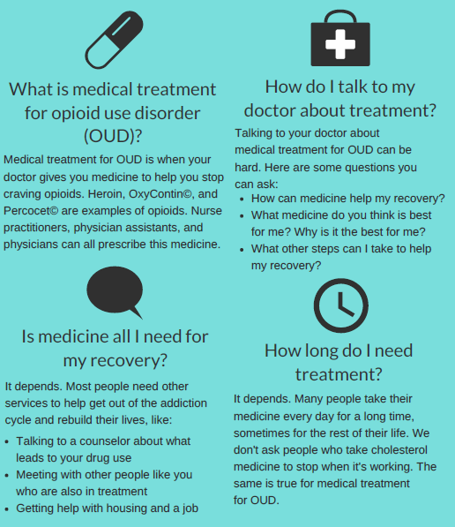

Resources: Make best practices easy to do
Health Literate Patient Brochure
MissouriOpioidSTR.org
Opioid STR listserv
Weekly statewide “Office Hours”
Pain and opioid brochures with DSS
Med First webinar series
ECHO sessions
STR Technical Assistance from ATTC
Implementation Guide for the Medical Treatment of OUD

Slide 41
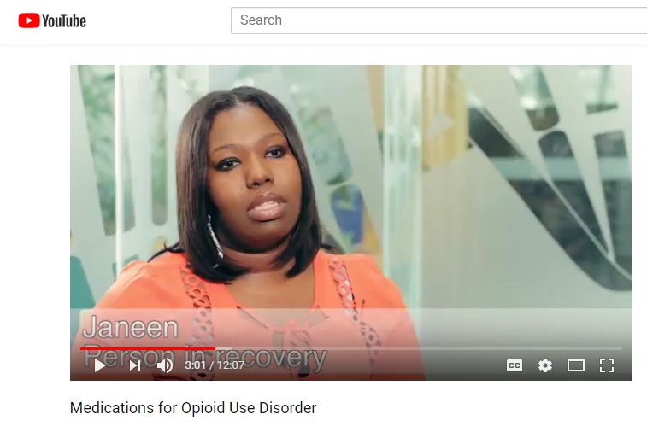

Slide 42

Next up… State Opioid Response grants ($36 billion in 2 years)

Slide 43

Staying course, beefing up
Prevention
  High-risk youth prevention through Boys and Girls Clubs throughout the state
  Opioid safety public information campaign at Historically Black Colleges and Universities
  Broad public messaging and awareness efforts on pain, suicidality, overdose risk, and harm reduction
  Street Overdose Prevention Outreach + Expanded reach into church and faith communities for training and education

Slide 44
Staying course, beefing up
Treatment
  Medical treatment of opioid use disorder in St. Louis County Jail
  Training on clinical decision-making related to PDMP utilization and opioid prescribing
  Expanded post-overdose support services – reaching more emergency departments and expanding to ambulance districts to connect with people who do not present at the hospital
  Addiction care navigators at high volume and highly affected programs and organizations
  The creation of an Addiction Medicine Fellowship program at St Louis University medical school
  Dissemination of a therapeutic phone application for pregnant and parenting women with opioid use disorder
  Funding for the KC Assessment and Triage Center to provide medical stabilization and treatment initiation
  Funding for Opioid Treatment Programs in rural areas to increase accessibility for low-income individuals
  Support for a Maternal and Neonatal Care Coordinator with the Missouri Hospital Association to disseminate best practices to reduce neonatal abstinence syndrome and improve maternal care

Slide 45
Staying course, beefing up
Recovery Support
  Expansion of services at Recovery Community Centers (employment training and connection; publicity of services; childcare; basic needs – blankets, hygiene kits, etc.)
  A second street outreach team in St. Louis to reach people who are homeless and actively using opioids
  Launching quality data collection and reporting on the role of Recovery Housing

Slide 46
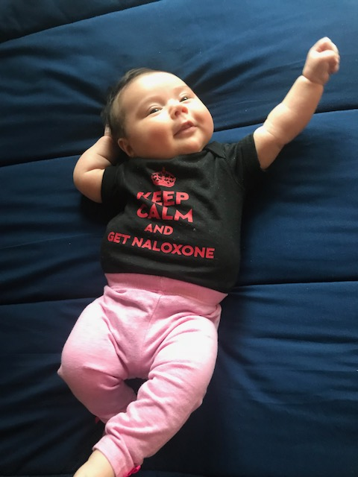
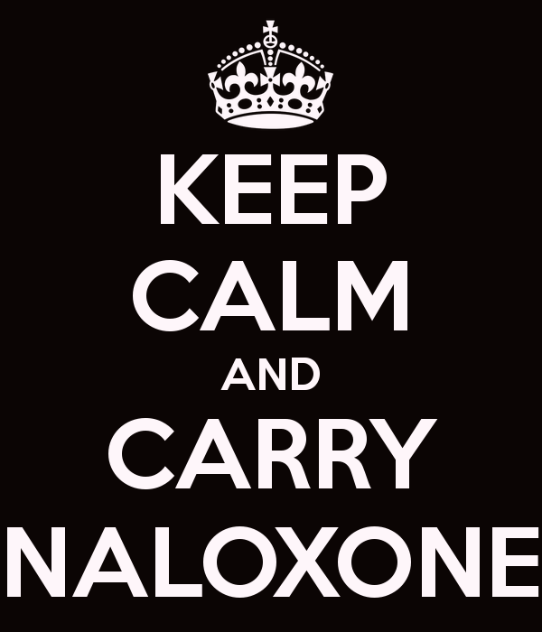
Questions?
Visit www.missouriopioidstr.org to learn more and sign up for our statewide listserv!

