Slide 1
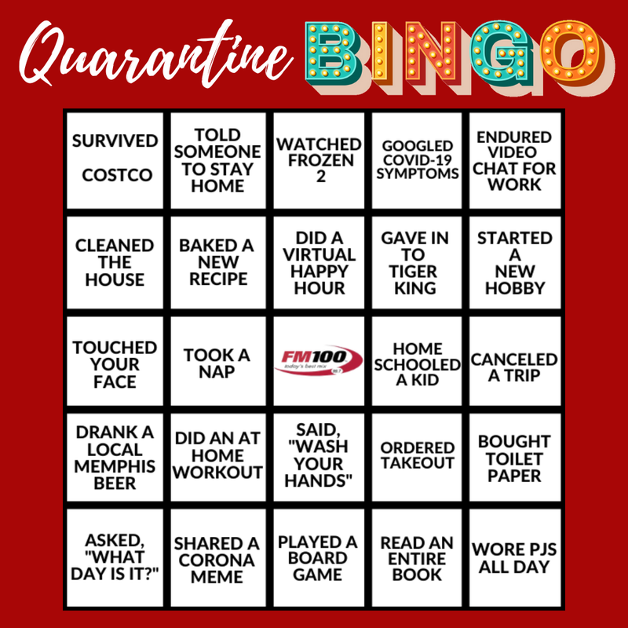
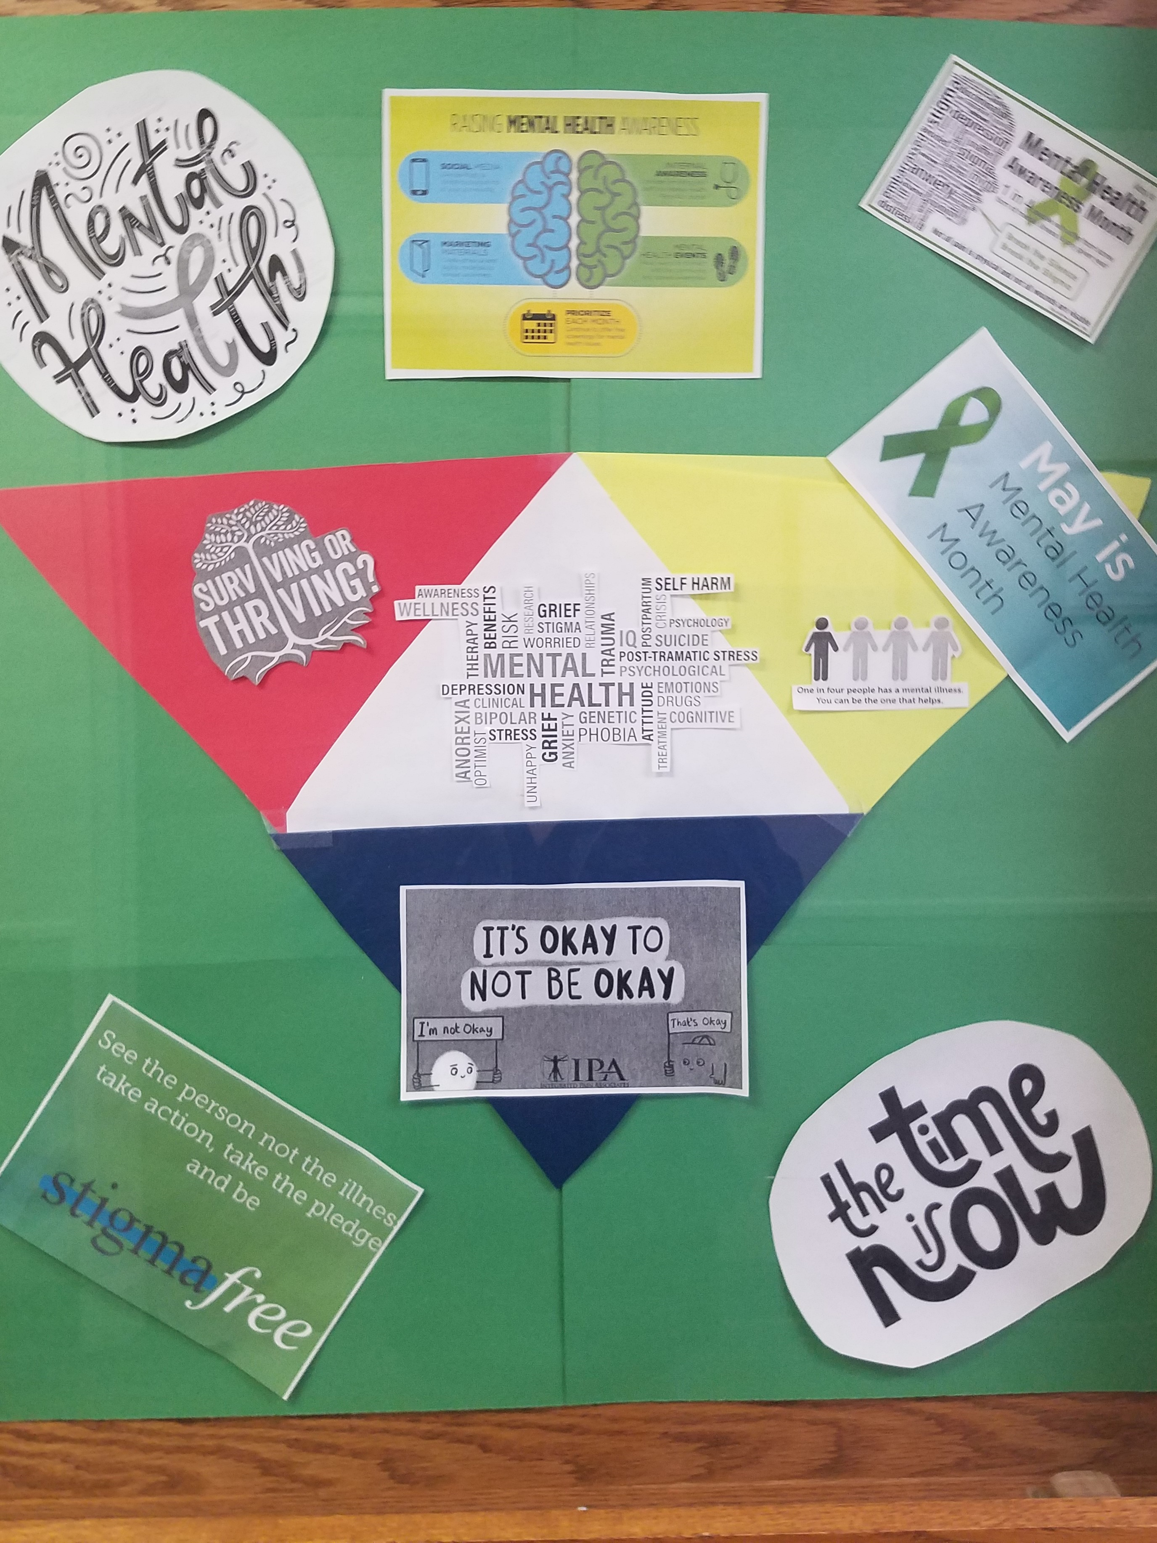
Rolla Regional Satellite Office
Jennifer O'Day, Assistant Director
Rolla Regional Satellite Office
105 Fairgrounds Rd. Rolla, MO 65401
573-368-2200
jennifer.oday@dmh.mo.gov
105 Fairgrounds Road
Rolla Mo
Agency Background
Data
Outcomes
1970’s RRSO was a diagnostic clinic which included a residential facility and day program until 1993
RRSO was the first region in the state to have all counties contracted for targeted case management
RRSO provides technical support to 9 TCM agencies and approximately 50 provider agencies
Motivation
Better Sleep
Increase Steps
What data do we have that shows our Wellness efforts are working?
“Motivation to get up and move”
“Trying to improve my sleep”
“To work toward logging 3000 steps per day”
More Energy
Healthy Goals
“My sleep has improved and I feel more energized and Happy!!”
“…helped me reach my personal health and wellness goals.”
Past
Past outcomes and achievements:
Created agency values with matrix
Enhanced new hire and orientation
Surveyed employees for input and “pulse”
Encouraged professional development
Improved communication by establishing an agency newsletter
Improved reinforcement by creating a virtual “shout out” board
Created one-page profiles for all staff
Drinking Healthy
Moving More
Eating Healthy
“…have stopped drinking soda.”
“I am moving more”
“…cooking healthy meals at least 5 to 6 days…”
Weight loss
Joined a Gym
Drinking water, have lost about 20 lbs.
“ Signed up for a membership at the gym”
Future
What’s next with this strategy
Continue to provide staff with information and ideas to remain healthy - mentally, physically and emotionally.
Assist with resources for coping/stress for the upcoming Distribution Work plan
Work/Life balance
Identify a way to quantitatively measure the effectiveness of our outcomes
Continue to survey staff to assess the success of our action plan.
Provide resources:
EAP
Stay-at-Work Program
UM Extension center
Increase membership/activity on private Wellness Committee Facebook page
Present
Promote wellness at RRO
Respond to staff surveys regarding preferred activities:
Gratitude challenge
Walking challenge
Tuesday Tips
Financial Wellness
Weight loss challenge
Create virtual games
Road to Resilience trauma committee
Promote and Encourage DMH Cares
Coffee Clatch, Tea time and Lunch Bunch
Active (private) Wellness Committee Facebook page
Promote/remind about Personal Wellness Leave
Workplace Ergonomics
Eye Health
Agency Core Values
C - Communication
R - Respect
E - Expertise/Professionalism
W - Work Cooperatively
Our “WHY”
“To have the best work environment to promote and inspire everyone in having a meaningful, fulfilling life”.

