Slide 1
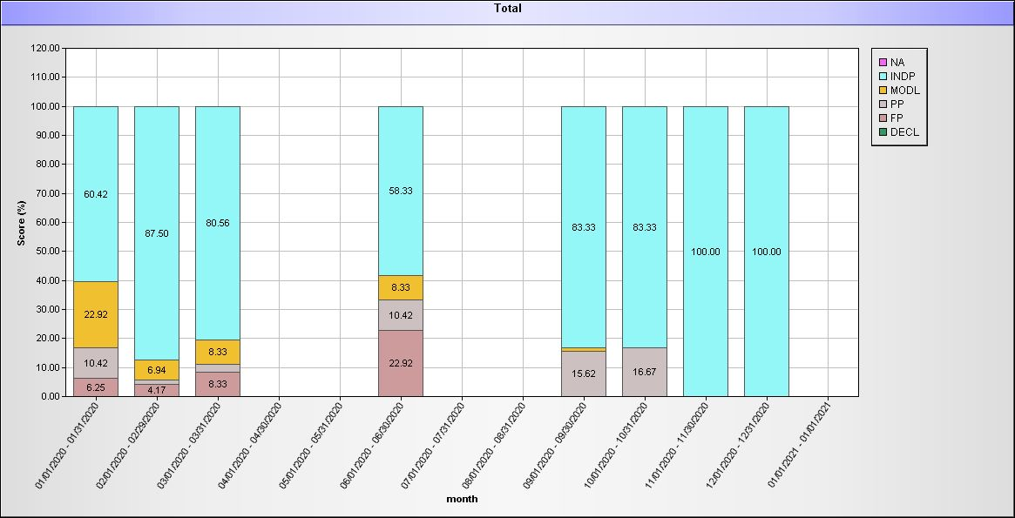
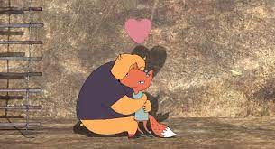
Rainbow Abilities Center: Improved Teaching Method
Contact information:
Assistant Director, Amber Novara amber@rainbowabilitiescenter.org
Agency Background
Data
Outcomes
Rainbow provides Day Habilitation/Medical Exception Day Habilitation services for the Franklin County Area
This bar graph reflects the data of how consistency of our teaching method over one year has helped one of our individuals reach 100% independence in handwashing! (YAY)
*Since implementing a more structured way of teaching (prompting levels with our teaching method) following BST we have found more objective data is being collected.
*Individuals have learned how to learn, and our DSPs are more successful with teaching our curriculum.
Past
Prior to developing our teaching method, we had identified full assistance with teaching new or revolving skills was very high. We came together as a team and developed our teaching method, using BST, and defined prompting levels. In 2020, RAC made the decision to go online with Therap, which helped us evolve our teaching method.
Future
Provide continuing education to our employees on how to best teach our individuals in being independently and having a meaningful day
Continuing to make a positive association with learning
Present
Presently, each skill we target has a modified Teaching Method attached to the task analysis. Explaining how do we teach others? Filled with step-by-step reinforcement, how to use BST and group conversations. This has relieved uncertainties for our DSP’s. This also has provided consistency for the individuals we serve to be as independent and successful as possible.
Agency Core Values
Respect
Advocate
Communicate

