Slide 1
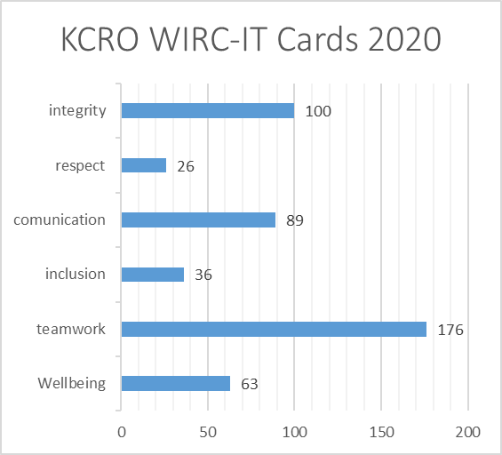
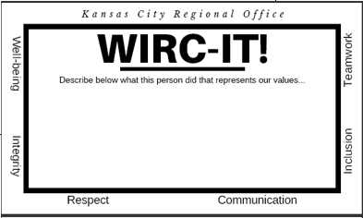
Tiered Supports in a Regional Office Setting
Tim Wholf
Lesa Tracy
Director – Kansas City Regional Office
Assistant Director – Kansa City Regional Office
Agency Background
Data
Outcomes
The Kansas City Regional Office officially opened August 9th, 1971. KCRO was the last of the nine clinics to open and initially opened with the name of Kansas city Regional Diagnostic Clinic. The first admission was August 9th, 1971.
Leadership:
Modeling & participating in the workshops to change the culture
Breaking down the silo’s:
Cross-training between teams, bringing similar team responsibilities together in one place
Buy – In:
“Why we do what we do” at team meetings,
Teams share updates at all staff, WIRC-IT cards
Goal 2021: Accountability:
Build up the skills and actions of our staff to meet the Regional Office Expectations
Past
Prior to becoming a Tiered Support agency, process and systems were defined by KCRO administration with little to no input from staff.
Future
The Kansas City Regional Office has been a Tiered Support agency since 2015, and are excited to continue building a better environment for the staff who inevitably impact the community, and it’s success.
Present
KCRO implemented a staff recognition system: WIRC-IT cards for the agency staff and leadership to recognize and reinforce the values which represents us as an organization.
By focusing on staff who demonstrate those values, we hoped to move toward an environment of support, communication, and inclusion.
Agency Core Values
Well-Being
Integrity
Respect
Communication
Inclusion
Teamwork
Thank you for helping set up for our All Staff Meeting! We appreciate your teamwork and integrity!
Contact Information:
Tim Wholf, Director
821 Admiral Blvd
KCMO, 64106
Tim.wholf@dmh.mo.gov

