Slide 1
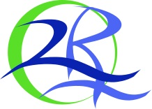
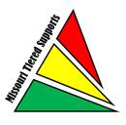

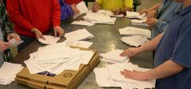

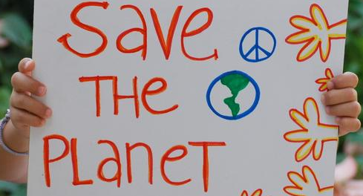
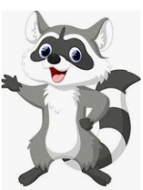
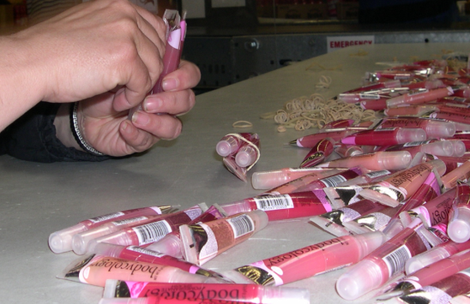

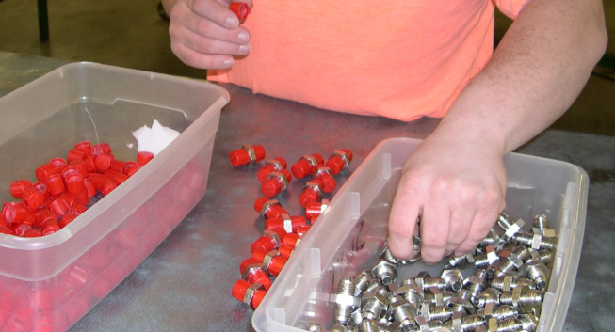


2 Rivers Industries, Inc. Poster Presentation
Our Motto: SPORT
Safety Productivity Optimism Responsibility Teamwork
2 Rivers Industries, Inc.
Tiered Supports Agency since 2017
Agency Background
For over 50 years the Northeast Missouri Sheltered Workshop, Inc. has operated in Hannibal, MO with the same mission and vision. In need of a change, a new Board of Directors was established, and Melonie Nevels was hired as the new Executive Director in 2014. Over course of a year they have evaluated activities, fostered new relationships and assessed the needs of the Workshop. A plan of action was developed for continuous improvement and sustainability emphasizing the abilities of the unique workforce through stable, meaningful and dignified employment opportunities reflecting the dedication and commitment to quality work and services for industry and the community.
Always focus on SAFETY in your work environment
Strengthen your PRODUCTIVITY to improve your meaningfulness.
Maintain OPTIMISM regarding your abilities.
Take RESPONSIBILITY for your own actions.
Demonstrate TEAMWORK in all areas of 2 Rivers Industries.
Past
Present
A Mission, Purpose and Vision were created and approved.
Our MISSION to continuously improve our organization by emphasizing the abilities of persons with disabilities through stable, meaningful and dignified employment opportunities, while providing training and supervision designed to increase skill levels and self-esteem for each employee. The PURPOSE of 2 Rivers Industries, Inc. is to provide disabled individuals employment opportunities that will increase task development, self-esteem and soft-skills. Our VISION is that disabled individuals will be empowered to work successfully in competitive employment within our community in a confident and secure manner.
A Leadership MOTTO was created. This MOTTO was designed with a duel purposes. First, Management and Supervisors refer to the MOTTO when interacting with others and providing direction to our employees. Second, Employees use this MOTTO as a guideline to complete the tasks within their daily job assignments. S.P.O.R.T. - Safety, Productivity, Optimism, Responsibility, Teamwork.
Integrate a mascot to educate our employees about recycling
and our facility. River the Raccoon was created to encourage
our employees through their work and to encourage the
children within the community to recycle. River makes
appearances at all of our events when certain encouragement
is needed. Additionally, River plays a role in recycling
education at the area elementary schools.
Development of Soft Skills Training that is being integrated into daily work habits to improve skills for our employees. These skills have been identified; however management is working on a quantitative measurement and perimeters for these measurements to have the ability to graph growth.
Effective May 1, 2015 the Board of Directors and Nevels announced that the Northeast Missouri Sheltered Workshop, Inc. will be doing business as 2 Rivers Industries, Inc. 2 Rivers Industries, Inc. brings not only a new name to the organization, but a new image, new vision and new opportunities for area businesses, citizens and employees. This new vision is a new beginning and opportunity to do things the right way and be a positive influence in the local community.
2 Rivers Industries' commitment to provide employment is constructed on developing strong relationships with the business community that are based on consistent dependable quality services and products. Services to area businesses include: packaging, mailing, assembly and similar productions related to fulfillment and delivery of their products.
Future
Management has seen that several employees in the past have had goals of seeking competitive employment and have utilized other resources to seek this employment. Many of these attempts have failed due to the employee being unsure of many of the soft skills requirements. 2 Rivers Industries, Inc. has started working on the development a program that will integrate a form of soft skills training into the employees daily working habits. Initially, all employees are introduced to the basic soft skills training which include, Attendance and Punctuality, General Appropriate Appearance, Communication related to tasks, and many more. Those employees that have a higher desire to achieve competitive employment will be moved into additional training which will include quantitative measurements that will be monitored over time to determine consistency. 2 Rivers Industries, Inc. has not successfully completed a quantitative measurement and clear perimeters for these measurements. This is the goal for 2020.
RIVER
Contact Information:
Melonie Nevels, Executive Director
2 Rivers Industries, Inc.
659 Clinic Rd. Hannibal, MO 63401
mnevels@2riversind.org
573-221-3211

