Slide 1



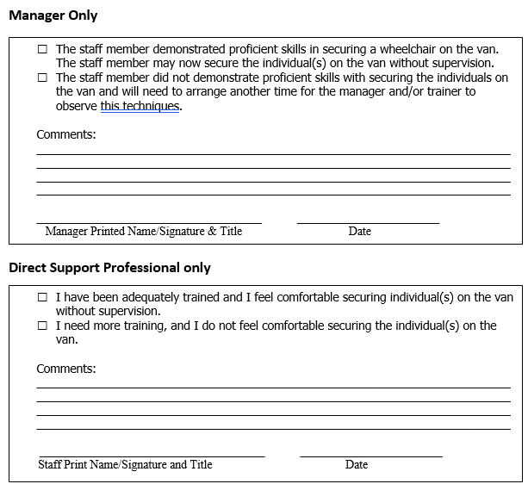



Wheelchair Transportation Safety Training
Our ‘Why’
Wheelchair Safety Curriculum
Policy/Procedure
Choices of St. Joseph, along with sister agency Heartland Residential Care, provides supports to individuals with intellectual disabilities in an ISL setting.
As our population has aged, and we have developed new ISLs, our number of individuals who utilize wheelchairs has doubled within the last two years.
We identified gaps in our Policies, Procedures, and Training to assure a supported individual has the best care possible.
We set out to assure our employees were not only properly trained, but felt comfortable and confident in performing their duties.
Components of the Wheelchair Safety Curriculum:
Wheelchair Safety Training listed on New Employee Orientation Checklist.
Transporting Individuals in Wheelchairs Training outline.
Wheelchair and Van safety Checklist
When the training is completed and the employee scores a satisfactory in all areas of Wheelchair and Van Safety, the signed Wheelchair Safety Training Curriculum will submitted to the QDDP and kept in the employees file.
.
All employees who work with individuals that utilize wheelchairs as adaptive equipment will be formally trained on Wheelchair Safety and Transporting Individuals in Wheelchairs utilizing the Wheelchair Safety Training Curriculum.
An employee may not transport an individual in a wheelchair alone until all components of the training is complete and satisfactory.
The Manager and/or the QDDP will conduct the Wheelchair Safety Training within the first ten days of hire if working at a location where individuals utilize wheelchairs, or before transporting an individual alone.
This will be a hands on training utilizing the Training Curriculum, the individual’s wheelchair, and the agency vehicle that will transport an individual.
Demographics
Established in 1988.
We support 110 wonderful individuals!
40 ISLs throughout St. Joseph and Kansas City
Over 300 employees
26 individuals utilizing wheelchairs
Doubled the number of individuals utilizing wheelchairs in two years.
Core Values
“Self-Determination”
“Meaningful Day”
“Building Relationships”
“Excellence”
Contact Information:
Maranda Story, Tari Hovey, Ronete McGaughy, QDDP
Choices of St. Joseph/Heartland Residential Care
Maranda@choicesofstjoseph.com
816-232-0768

