Slide 1
Housing First, what is it anyway?
Amy Copeland, M.S., LPC
Affordable Housing Consultant

Slide 2
What is housing first?
The National Alliance to End Homelessness said:
“Housing First is a homeless assistance approach that prioritizes providing permanent housing to people experiencing homelessness, thus ending their homelessness and serving as a platform from which they can pursue personal goals and improve their quality of life. This approach is guided by the belief that people need basic necessities like food and a place to live before attending to anything less critical, such as getting a job, budgeting properly, or attending to substance use issues.”

Slide 3
Additionally, Housing First is…
“…based on the theory that client choice is valuable in housing selection and supportive service participation, and that exercising that choice is likely to make a client more successful in remaining housed and improving their life.”

Slide 4
Housing First Principles
1. Immediate Access to housing with no housing readiness conditions
meet the person with support; however, housing is not dependent upon engagement
2. Consumer Choice and self determination
choice in housing, goals are possible
3. Recovery orientation
work on self defined goals
4. Individualized and person driven supports
fits person, not what we think the person needs
5. Social and community integration
https://www.youtube.com/watch?v=pwdq2VWavtc

Slide 5
Housing First
How is it different from other approaches?

Slide 6
Housing First replaced a Continuum model
The Housing Continuum model (also called housing readiness) emphasized moving individuals through different levels of care, moving from more structure to less, less independence to more. It was based on the notion that certain skills had to be taught before people could move into independent housing of their choice.
Group home
Semi independent
Independent housing

Slide 7
Problems with Housing Readiness Continuum
Mental Illness is not a linear process
It did not take into consideration individual choice
Skills are best learned/taught in the environment where they will actually be used
The sickest people were often left out of housing altogether because they could not engage with this process
Homelessness is traumatic and keeping people homeless until they were “ready” for housing often led to more disability and even death
People have a better chance of getting better and doing better when they are safely housed in housing of their choice.

Slide 8
What it is…
A collaboration to serve neighbors including those who are homeless.
Doing anything necessary to keep people housed, i.e. (Shen. G. – flooding unit)
Every person is of value.
It is not helpful to blame someone for where they are…when you don’t know better, you will not be able to do better. Learning curve.
Recognizes the complexities of the different factors that can shape a human life.
Meet the person where they are, not where we think they should be (David R.).
Stop it video https://www.youtube.com/watch?v=Ow0lr63y4Mw

Slide 9
Who can it benefit?
Because the Housing First approach is flexible and responsive, it can be tailored to anyone; therefore, it can benefit both homeless individuals and families with any degree of service needs.
It can end homelessness for a household who became homeless due to a temporary personal or financial crisis and has limited service needs, only needing help accessing and securing permanent housing.
It can be a particularly effective approach to end homelessness for high need populations, such as chronically homeless individuals.

Slide 10
Homelessness
Defined by HUD

Slide 11
Category 1 – Literally Homeless: Individual or family who lacks a fixed, regular, and adequate nighttime residence, meaning:
  (i) Has a primary nighttime residence that is a public or private place not meant for human habitation;
  (ii) Is living in a publicly or privately operated shelter designated to provide temporary living arrangements (including congregate shelters, transitional housing, and hotels and motels paid for by charitable organizations or by federal, state and local government programs); or
  (iii) Is exiting an institution where (s)he has resided for 90 days or less and who resided in an emergency shelter or place not meant for human habitation immediately before entering that institution.
Category 4 – Fleeing or Attempting to Flee Domestic Violence: Any individual or family who:
  (i) Is fleeing, or is attempting to flee, domestic violence;
  (ii) Has no other residence; and
  (iii) Lacks the resources or support networks to obtain other
  permanent housing

Slide 12
Chronic Homelessness…what it was
First, let’s look at the traditional definition. Chronic homelessness has been defined as a single individual (or head of household) with a disabling condition who has either:
  Experienced homelessness for longer than a year, during which time the individual may have lived in a shelter, Safe Haven, or a place not meant for human habitation.
  Or experienced homelessness four or more times in the last three years.

Slide 13
Chronic Homelessness…new definition
First, in terms of length of homelessness, the four episodes now have to add up to 12 months. Before this new definition, an individual could technically be homeless four different days over a three-year period and be classified as chronically homeless.
Second, previously people who exited institutional care facilities after spending fewer than 90 days there would not have that period counted toward their homelessness. Now, it will be.
Third, the time between periods of homelessness has now been defined as seven days in order for the period of homelessness to constitute an “episode. “
Finally, HUD has clarified the ways in which service providers should verify whether an individual’s homelessness experience meets the definition of chronic homelessness.

Slide 14
Homelessness – what does it look like
Continuing challenge for many cities throughout our country.
Homeless population falls into three categories:
    Temporary homeless = 76%
    Episodic homeless = 10%
    Chronic homeless = 15% (which uses 50% to 60% of the resources)
In 2018, MO had 5,883 persons experiencing homelessness on any given night, so that 10 homeless for every 10,000 people.

Slide 15
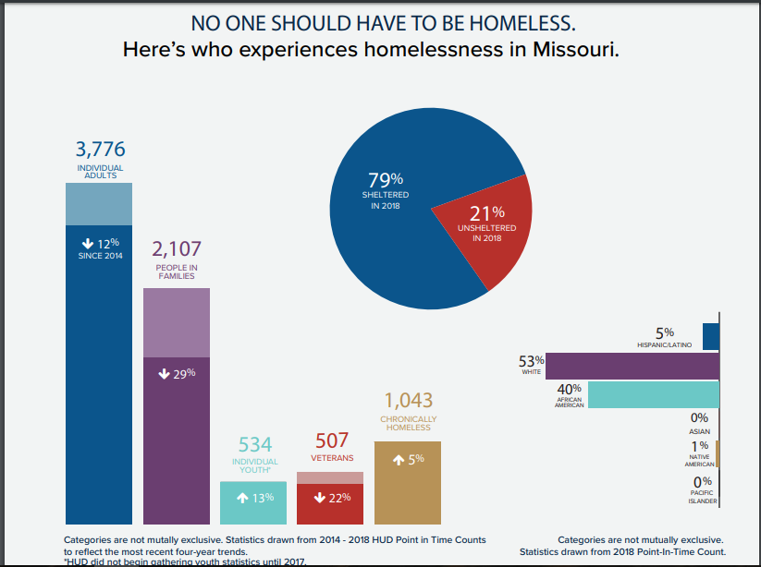

Slide 16
Housing First program elements
Housing First programs often provide rental assistance that varies in duration depending on the household’s needs.
Consumers sign a standard lease and are able to access supports as necessary to help them do so.
A variety of voluntary services may be used to promote housing stability and well-being during and following housing placement.

Slide 17
Ways to do it
PSH Permanent supportive housing (PSH) is targeted to individuals and families with chronic illnesses, disabilities, mental health issues, or substance use disorders who have experienced long-term or repeated homelessness. It provides long-term rental assistance and supportive services.
RRH – goals- obtain housing quickly, increase self-sufficiency, and remain housed. The Core Components of rapid re-housing—housing identification, rent and move-in assistance, and case management and services—operationalize Housing First principals.

Slide 18
Does it work?
There is a large and growing evidence base demonstrating that Housing First is an effective solution to homelessness. Consumers in a Housing First model access housing faster and are more likely to remain stably housed. This is true for both PSH and rapid re-housing programs. PSH has a long-term housing retention rate of up to 98%. Studies have shown that rapid re-housing helps people exit homelessness quickly—in one study, an average of two months—and remain housed. A variety of studies have shown that between 75% and 91% of households remain housed a year after being rapidly re-housed.

Slide 19
Does it work?
More extensive studies have been completed on PSH finding that clients report an increase in perceived levels of autonomy, choice, and control in Housing First programs. A majority of clients are found to participate in the optional supportive services provided, often resulting in greater housing stability. Clients using supportive services are more likely to participate in job training programs, attend school, discontinue substance use, have fewer instances of domestic violence, and spend fewer days hospitalized than those not participating.

Slide 20
Does it work: National Alliance to End Homelessness…
Fact Sheet about Housing First, April 2016
Finally, permanent supportive housing has been found to be cost efficient. Providing access to housing generally results in cost savings for communities because housed people are less likely to use emergency services, including hospitals, jails, and emergency shelter, than those who are homeless. One study found an average cost savings on emergency services of $31,545 per person housed in a Housing First program over the course of two years. Another study showed that a Housing First program could cost up to $23,000 less per consumer per year than a shelter program.”

Slide 21
So, Housing First is…
…an approach to quickly and successfully connect individuals and families experiencing homelessness to permanent housing without preconditions and barriers to entry, such as sobriety, treatment or service participation requirements.
It never has been housing only, and it never should be. Supportive services are part of the Housing First model. That might include formal support services, like a doctor, therapist, or social worker. It might involve informal supports, like connecting with family, friends, or faith groups.
https://www.youtube.com/watch?v=Dal6RuJc2t4

Slide 22
How it got started?
Sam Tsemberis, PhD as CEO and Founder of Pathways to Housing, Inc. came up with Housing First in 1992…Housing With Support
Prior to this, we had been doing the treatment first before housing. Didn’t house you until you were “housing ready”
Housing First put aside our own beliefs of what’s possible.
Allows ourselves to be changed by the needs and wants of the person, as opposed to our needs and wants for them.
Cheaper to house people – housing is the basic foundation

Slide 23
Housing with Supports
Housing:
Housing is a basic human right
No assessment of housing readiness
Scattered site housing; independent apartments
Separation of Housing and Services
…with Supports:
Respect, warmth, and compassion for all clients
Consumer choice and self-determination
Recovery orientation: support clients in their process of recovery
A commitment of working with clients for as long as they need
Harm reduction

Slide 24
Housing First - Learning Process
We make adjustments and try again
Results:
  Reduces ER visits
  Reduces hospitalization
  Reduces shelter use
  Reduces detox services
  Reduces incarceration
  HIV viral suppression, i.e.: KC 245 of 295 served are virally surpassed = 83%
  Every person is treated as a human being
Notes:
Year to date, there are 83% of clients served who are currently virally suppressed. That’s 245 people out of 295 served.
Notes about viral suppression:
Viral suppression is the amount of HIV in the bloodstream. Being virally suppressed means you have a low level because you’re adherent to medication. This is an important health indicator at an individual level (they live longer/healthier lives), and from a public health perspective (folks can achieve such a suppressed viral load (undetectable) that

Slide 25
Housing first & Harm Reduction
If you are going to effectively implement a housing first approach you will inevitably also have to use a harm reduction philosophy.
So…meet people where they are…but don’t leave them there.

Slide 26
Key principles of harm reduction
Public health approach aimed at reducing harm associated with various conditions (addictions, HIV/AIDS, untreated mental illness/psychosis)
It is non judgmental. It is a social justice issue rooted in unconditional positive regard for the individual. May require a major philosophical shift in thinking.
The focus is not on drug use, sexual activity, treatment non compliance but rather on keeping a person as safe as possible and reducing harm associated with those conditions until they choose to move further along in their recovery
i.e.: David R, Paul W. - house

Slide 27
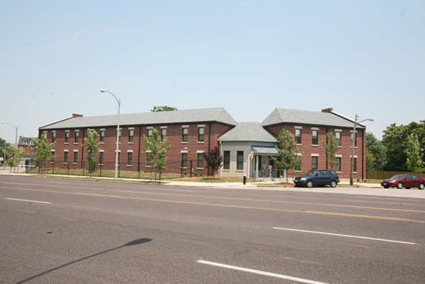
CJ’s Place/Sullivan Street
First intentional housing first/harm reduction model in Missouri
For people with history of homelessness, serious mental illness, addiction, HIV/AIDS – Charity Jean’s Place

Slide 28
CJs Places outcomes
Continuous housing
Reduced ER use
Reduced hospital Re-admits
100% of tenants moved further along in stage of change or changed to safer behaviors
A supportive community developed
This Photo by Unknown Author is licensed under CC BY

Slide 29
Asking the Right Questions
Does housing first work? IS NOT THE RIGHT QUESTION
When does it work?
Who does it work best for?
What do we have to do to make it work?
What do we do when it doesn’t work and what does that really mean?

Slide 30
Things we may have to change to make it work better
Modify the physical plant – i.e.: monitored single entry, alter appliances to protect from fires/burns/smoking mishaps (fire starter = cinderblock building)
Modify the way services are delivered – ongoing outreach and engagement, relationship and community building
Modify (eliminate) rules not related to lease
Focus on reducing harm rather than reducing drug use, interventions appropriate to stage of change
Modify our attitudes. People know when they are being judged, when they are not welcome.
Focus on people’s strengths and resilience

Slide 31
Array of Housing Options and Making the Right Match
Assumptions:
There is no such thing as one size fits all in permanent supported housing.
People have better chance of success if the housing and the services are appropriate to their individual needs, preferences, and history.

Slide 32
Examples of Different Models of PSH
Scattered Site with services brought to the individual
Clustered Apartments without on site services but tenants form supportive community – i.e.: Delancey Street in San Francisco
Clustered Apartments with on site services
  Clustered Apartments with on site services and monitored entry
Intentional Communities – shared housing

Slide 33
Examples
Bill – chronically homeless individual with both severe and persistent mental illness and substance use disorder. Has a lot of health concerns. Prior to receiving housing, he was living in a two man tent that he had in a dilapidated building that was unsafe, unsanitary, and cold. He has now been housed for four years and is receiving SSI.
Wendy L. – slept in abandoned houses. She is now stably housed and is doing outstanding and has also been housed in the same place for four years. Wendy is now receiving SSI.

Slide 34
COMMON CHALLENGES
Working With Landlords – often a challenge. Look for mission driven landlords, i.e.: Gateway Housing First, Vecino Group
Damages – is there a Regional Repair Pool or an Agency maintenance person?
Nuisance laws
Uninformed – get folks to take Mental Health First Aid

Slide 35
Engaging in services
Different paradigm – We are used to people asking for services. This model may require more assertive outreach/inreach after housed.
All About relationships
Non intrusive
Supportive
Providing tangible needs the tenant identifies

Slide 36
Anticipate and Plan
In a housing first model you may not have the advantage of knowing the person or having a relationship but you can anticipate the kinds of issues that may arise and make a plan
Decisions about mix of tenants
Explain to tenant ahead of time the various roles of different staff or agencies involved. Who is landlord, who is service provider, who is advocate
Explain this is a harm reduction housing program (if it is) so they understand they can be honest about their use.
Plan for relapse
Conversation about consequences of lease violation
Eviction Prevention plan

Slide 37
Understanding Appropriate Interventions for Stage of Change
Safety First
  How and where and with whom to use
  Negotiating safety for sex workers
  Programs with on site staff can support tenants safety challenges by helping them say no and banning certain people
  Have plan for overdoses
  Plans for Emergency support for children (who to call, what to expect, where can they go)

Slide 38
Understanding our “Failures”
As important as our successes is learning from the people who don’t successfully keep housing
What went wrong, what should have been in place that wasn’t?
Was there something about the physical plant, the location, the services or lack there of?
Did the person really need long term hospital stay rather than placement
Was the right housing model not available?
Answers to these questions can inform future plans and needs assessments

Slide 39
UN Declaration of Human Rights
Equal and non-discriminatory access to adequate housing;
Adequate housing must provide more than four walls and a roof. A number of conditions must be met before particular forms of shelter can be considered to constitute “adequate housing.” These elements are just as fundamental as the basic supply and availability of housing.

Slide 40
References
National Alliance to End Homelessness
Corporation for Supportive Housing
U.S. Department of Housing and Urban Development
Universal Declaration of Human Rights
Office of United Nations High Commissioner for Human Rights

Slide 41
Questions
Is Housing First Feasible?
Is it appropriate for everyone? Why or why not?
Other questions?

Slide 42
Thank you!
Amy Copeland, M.S., LPC
Affordable Housing Consultant
Missouri Department of Mental Health – Housing Unit

