Slide 1
Driver Diagram Discussion

Slide 2
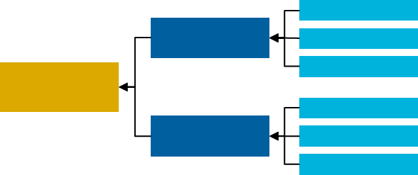
Key Tool: Driver Diagrams
A driver diagram is a way of describing the elements that need to be in place to achieve an improvement aim.
Aim
Primary Drivers
Secondary Drivers
The aim is a clearly articulated goal or objective of the work.
Primary drivers are system components or factors which contribute directly to achieving the aim
Secondary drivers are actions, interventions, or lower-level components necessary to achieving the primary drivers

Slide 3
What Makes a Good Aim?
It’s a Vision that Resonates and is Meaningful. It inspires people to do the work and generates stakeholder buy-in.
It’s Measureable and Time-bound, the data exist, and we are able to collect it.
It’s Ambitious and not something that has already been accomplished.

Slide 4
Aim Statement Drafts
React and Refine
Improve Independence
Increase by 20% the number of members receiving personal care services who are employed at least six months out of the year by 2021. (Data source and baseline)
2. Reduce Utilization
Reduce by 20% the emergency department utilization rate of those receiving personal care services through waivers and the State Plan by 2021. (Data source and baseline)
3. Qualified Service Providers
Increase by 30% the number of attendant care service providers receiving TBD certification/training by 2021. (Data source and baseline)
4. Customer Satisfaction
Increase by 20% the customer satisfaction rate for those receiving attendant care services by 2021. (Data source and baseline)

Slide 5
Aim Statement Discussion
How Can We Improve These? Which is the Right One?
Improve Independence
Increase by (A) 20% the number of (B) members receiving personal care services who are (C) employed at least six months out of the year by 2021. (Data source and baseline)
Is this ambitious?
Is this the population we want to focus on? Can it be narrowed to a geographic region or subpopulation?
Employed? Moved out of a nursing facility to family (setting)? Average need for service reduced?
2. Reduce Utilization
Reduce by (A) 20% the (B) emergency department utilization rate of (C) those receiving personal care services through waivers and the State Plan by 2021. (Data source and baseline)
(A) Is this ambitious?
(B) Focus on avoidable ER visits? Focus on reducing/controlling avoidable acute events that lead to ER visits?
(C) Is this the population we want to focus on? Can it be narrowed to a geographic region or subpopulation?

Slide 6
Aim Statement Discussion
How Can We Improve These? Which is the Right One?
3. Qualified Service Providers
Increase by (A) 30% the number of (B) attendant care service providers receiving (C) TBD certification/training by 2021. (Data source and baseline)
Is this ambitious?
Should we narrow to a specific subset of personal care providers?
Is there a good certification or training that is not required, but would be helpful and could be incentivized? Should we change to staff stability (e.g., the % turnover)?
4. Customer Satisfaction
Increase by (A) 20% the (B) customer satisfaction rate for (C) those receiving attendant care services by 2021. (Data source and baseline)
Is this ambitious?
What does the customer satisfaction rate entail? Can this be made more clear or specific?
Is this the population we want to focus on? Can it be narrowed to a geographic region or subpopulation?

Slide 7
What One Thing?
What one barrier or problem must you overcome to achieve your aim?
For Example: “Beneficiaries in the state are not aware of the health issue or the resources that are available to help with the issue”

